Slide 1



Welcome to NSOP Spring 25
C/Al Luhaibat & C/Osborne Mahiques
AFROTC Detachment 842, UTSA

Slide 2
Commander’s Brief
Colonel Cyrus
AFROTC Detachment 842, UTSA

Slide 3
Welcome to Det 842
C/Vallor
AFROTC Detachment 842, UTSA

Slide 4

Overview
Who We Are
Who Am I
What You Can Do
Tips for First Week
Summary
Air Force ROTC Detachment 842 • We Build Exceptional Officers • The University of Texas at San Antonio

Slide 5
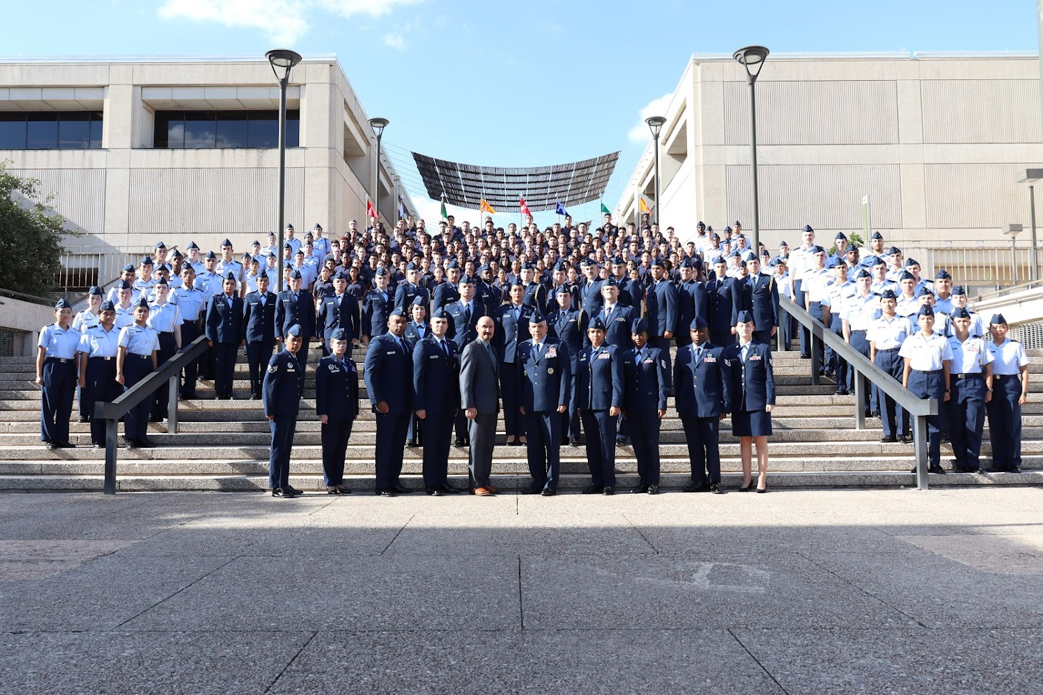
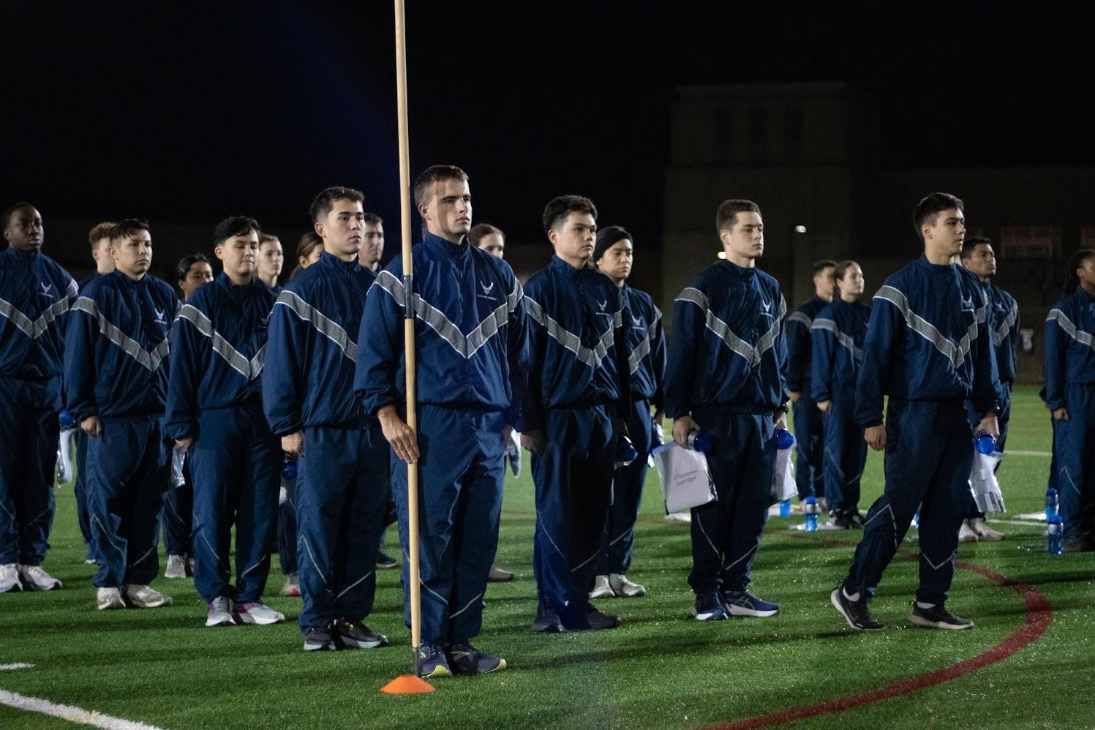
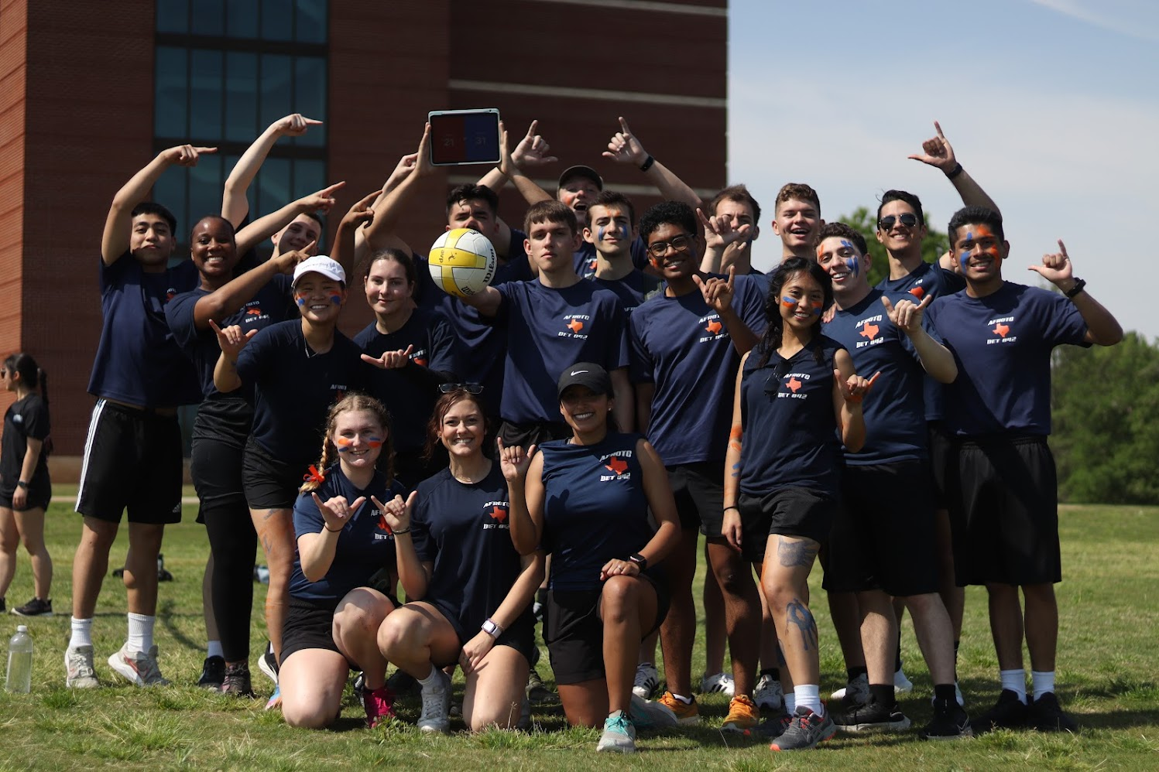
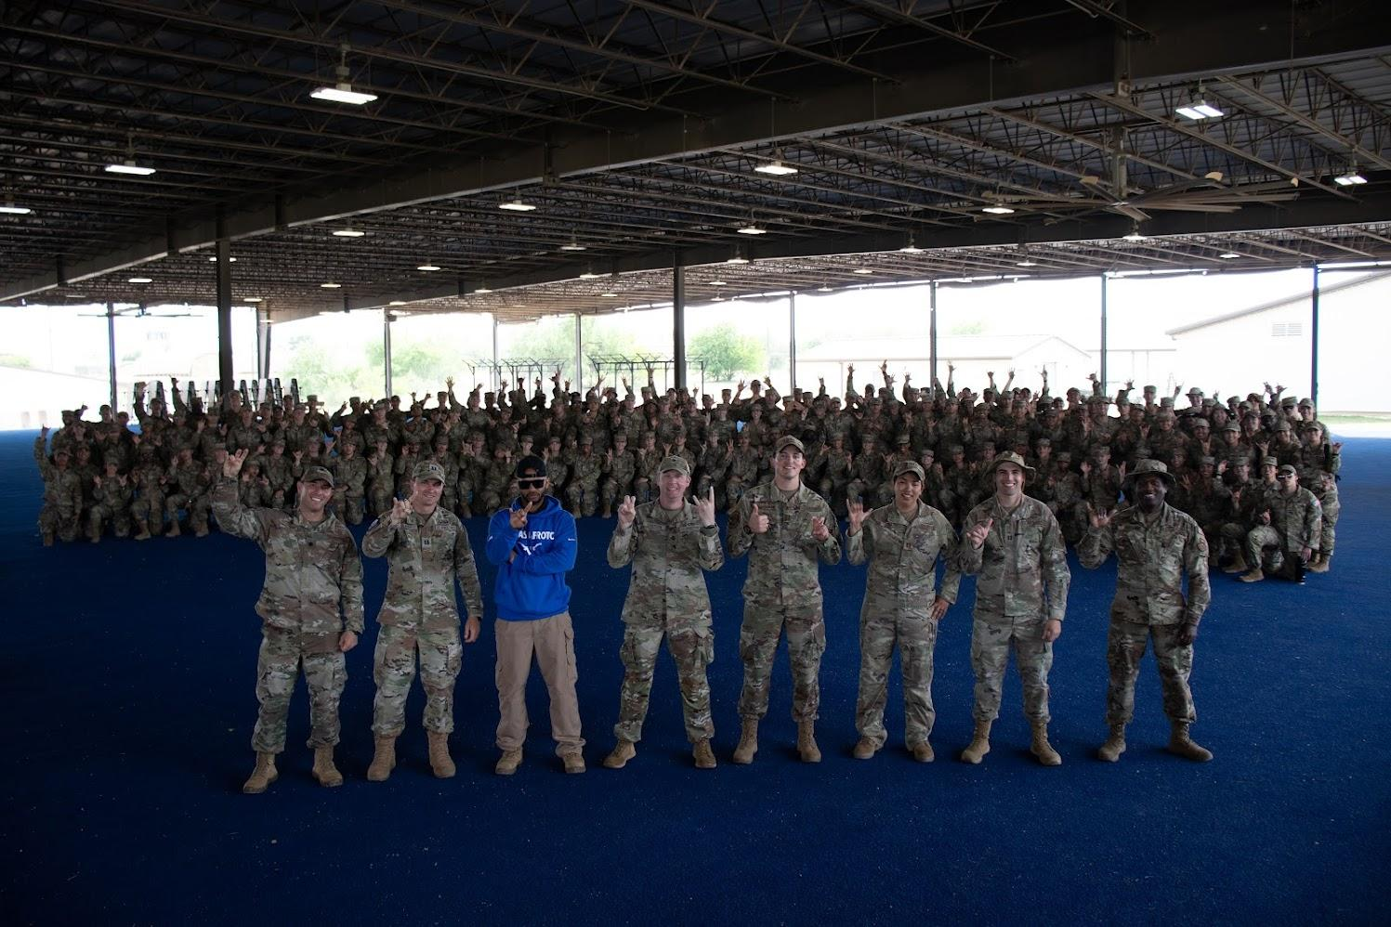
Who We Are
Air Force ROTC Detachment 842 • We Build Exceptional Officers • The University of Texas at San Antonio

Slide 6
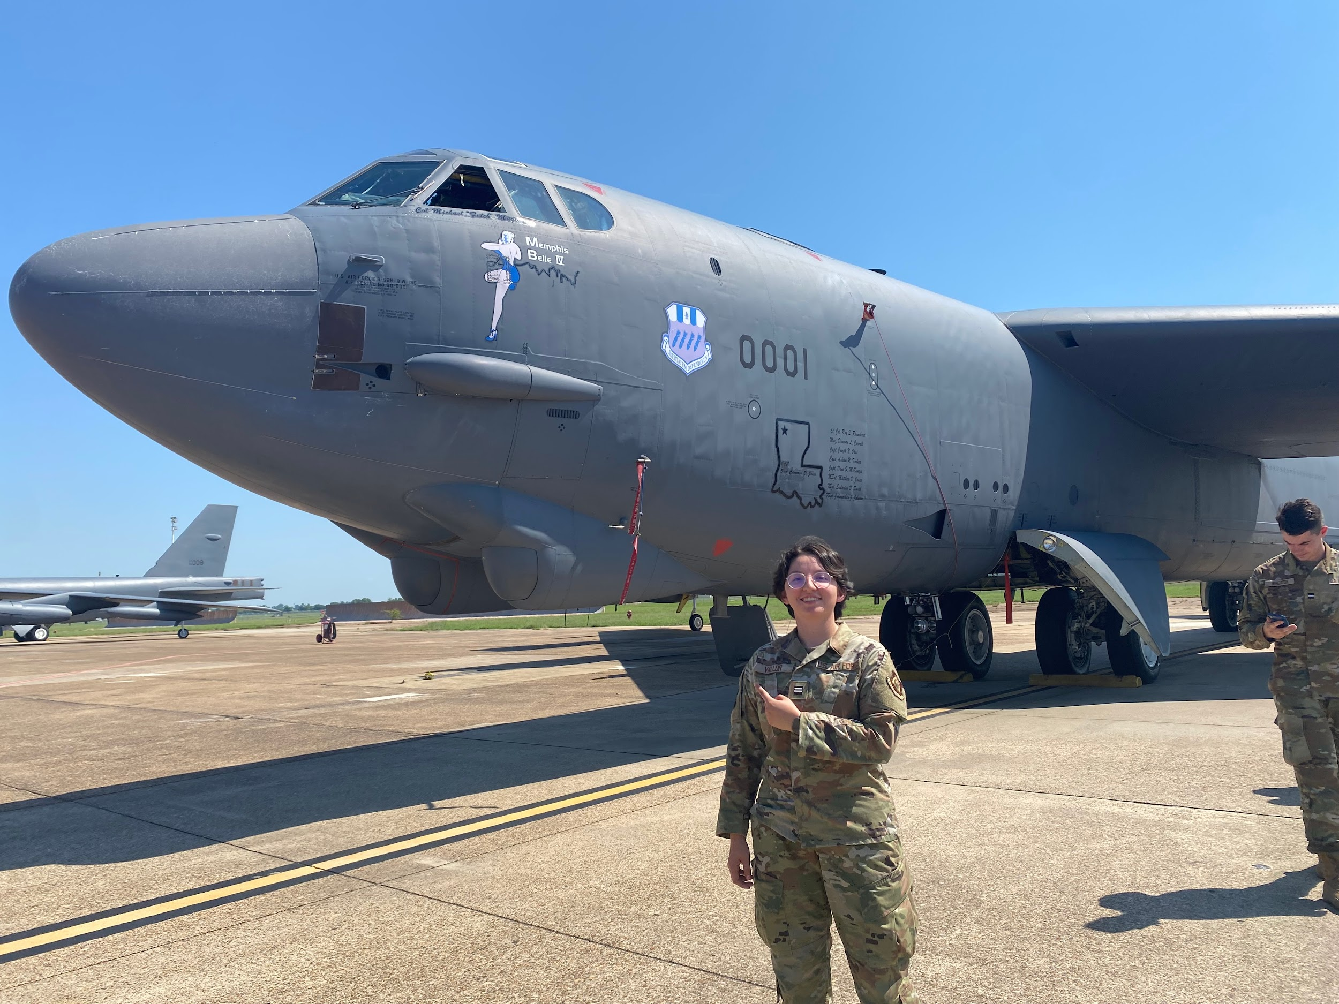
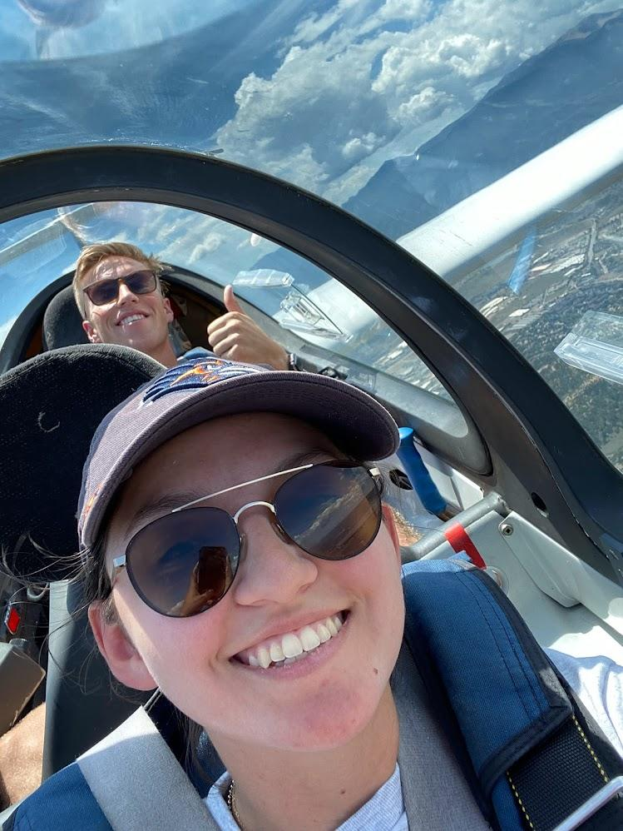
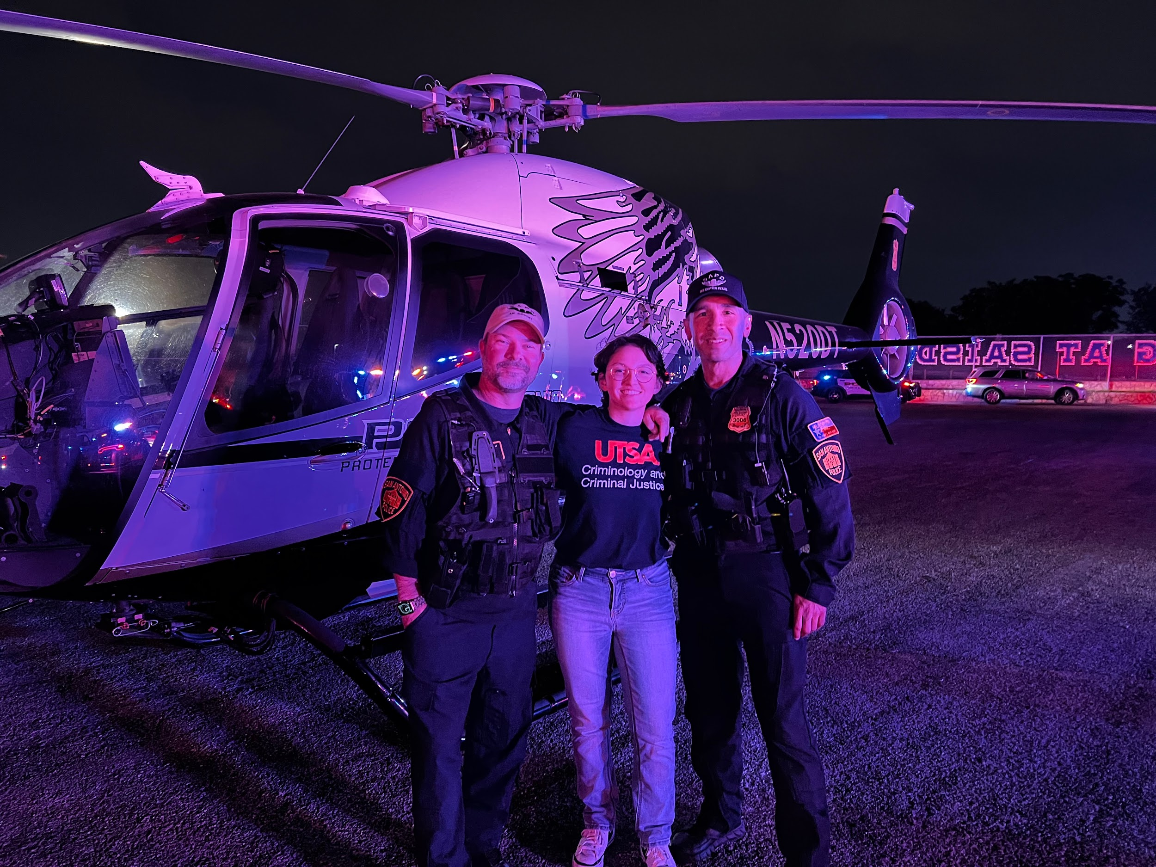
Who Am I?
C/Vallor - Wing CC
Major: Criminal Justice
AFSC: Combat Systems Officer
Cool Things Det 842 Gave Me:
Fly Cool Planes
Visit Cool Places
Meet Cooler People
Air Force ROTC Detachment 842 • We Build Exceptional Officers • The University of Texas at San Antonio
Notes:
Personal Anecdotes to this slide of course

Slide 7
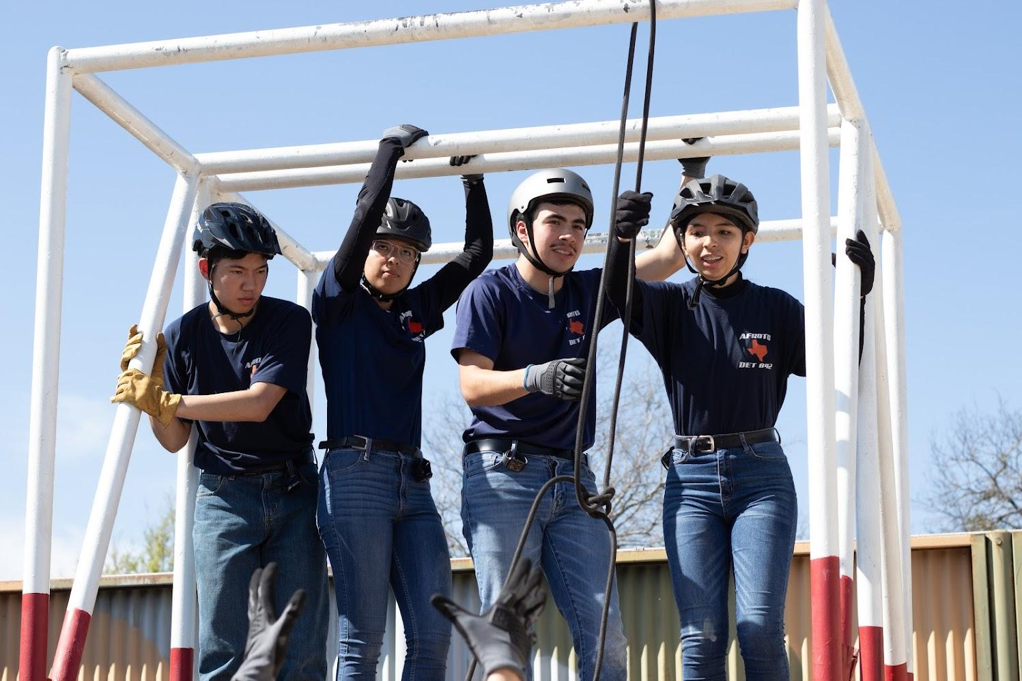
What To Expect
Expect to be Challenged
Physically
Academically
Expect to Develop
Confidence
Leadership
Air Force ROTC Detachment 842 • We Build Exceptional Officers • The University of Texas at San Antonio

Slide 8
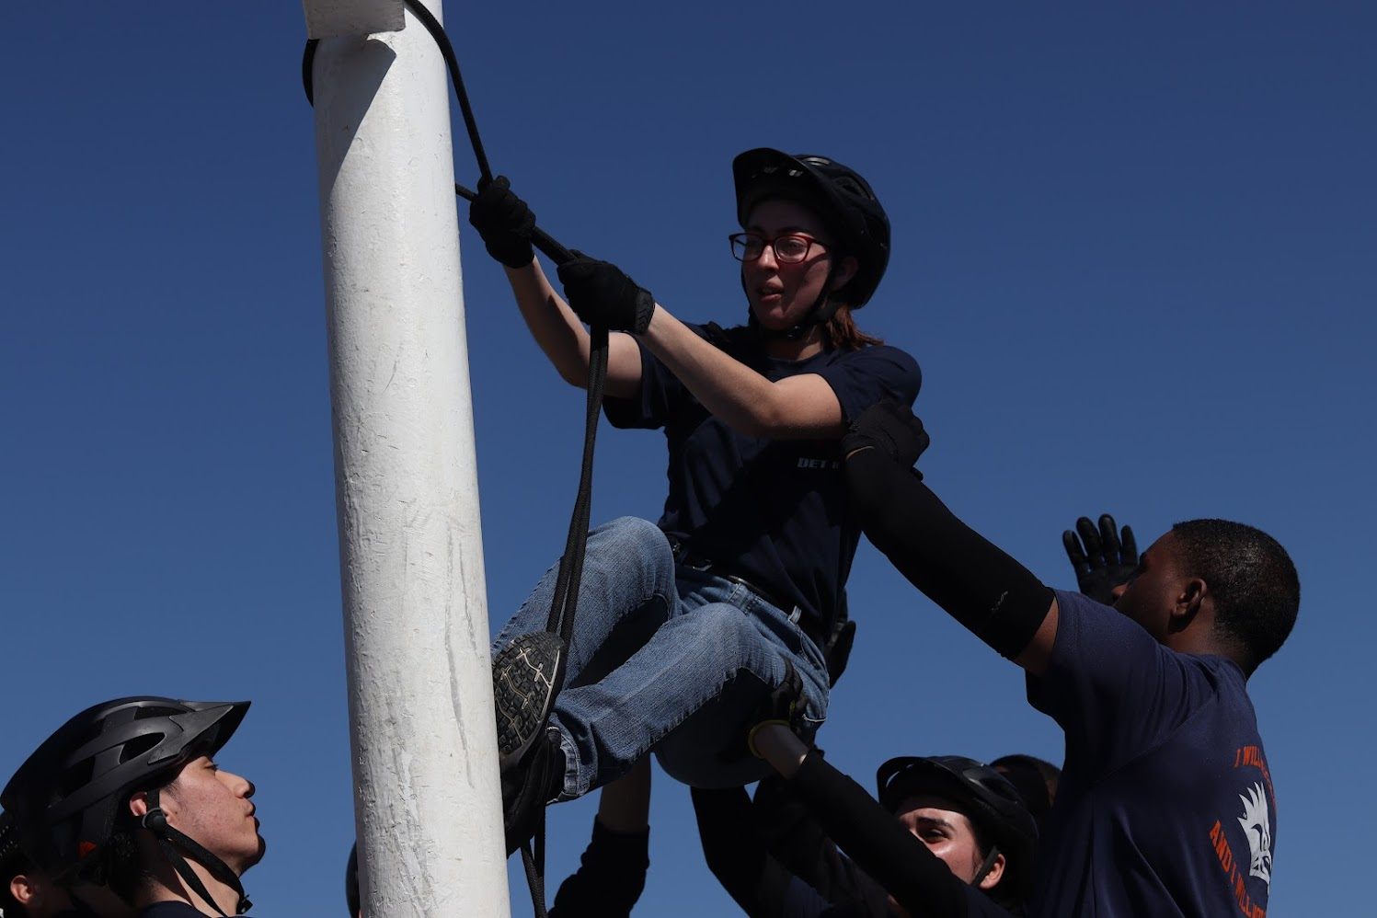
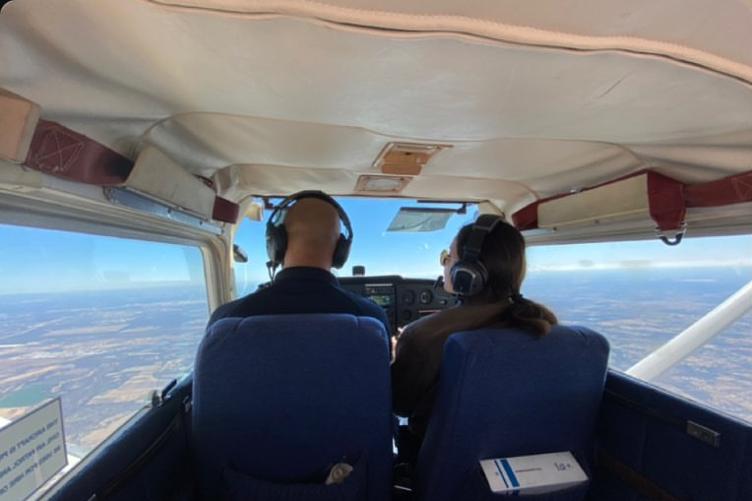
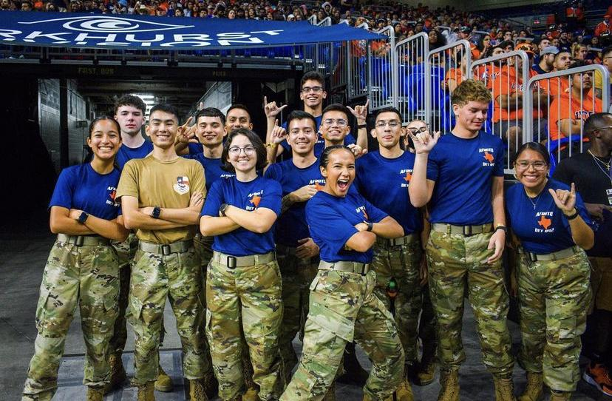
What You Can Do
There are many more unique people and experiences you can create at Det 842
Take Risks
Learn New Skills
Make New Memories
Air Force ROTC Detachment 842 • We Build Exceptional Officers • The University of Texas at San Antonio

Slide 9
Tips for First Week
Be a sponge
Communicate with your peers
Stay Flexible
Make Mistakes!
Air Force ROTC Detachment 842 • We Build Exceptional Officers • The University of Texas at San Antonio

Slide 10
Summary
Who We Are
Who Am I
What You Can Do
Tips for First Week
Summary
Air Force ROTC Detachment 842 • We Build Exceptional Officers • The University of Texas at San Antonio

Slide 11
Questions?

Slide 12
Dress & Appearance
Cadets Olivares & Azameti
AFROTC Detachment 842, UTSA, 17 JAN 25

Slide 13
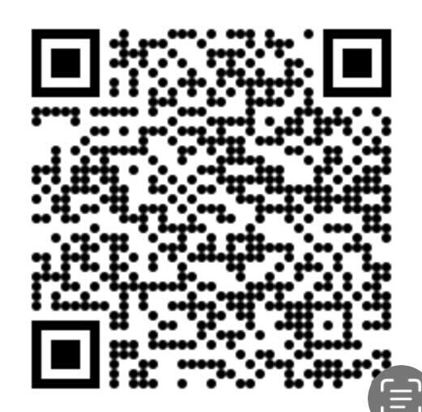
Overview
What is DAFI 36-2903?
Male Hair Standards
Female Hair Standards
Nail Standards
Jewelry
Uniforms
Uniform Etiquette
Summary
Questions
Air Force ROTC Detachment 842 • We Build Exceptional Officers • The University of Texas at San Antonio

Slide 14

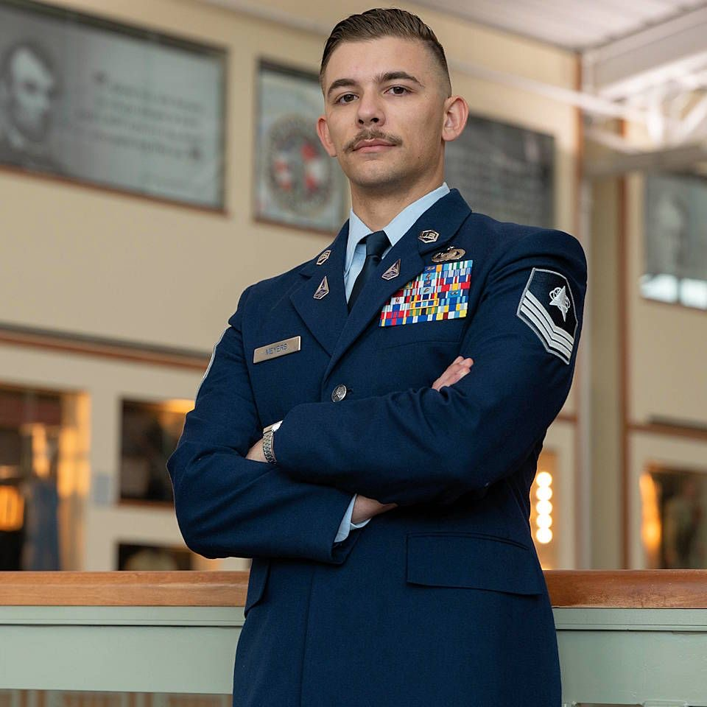
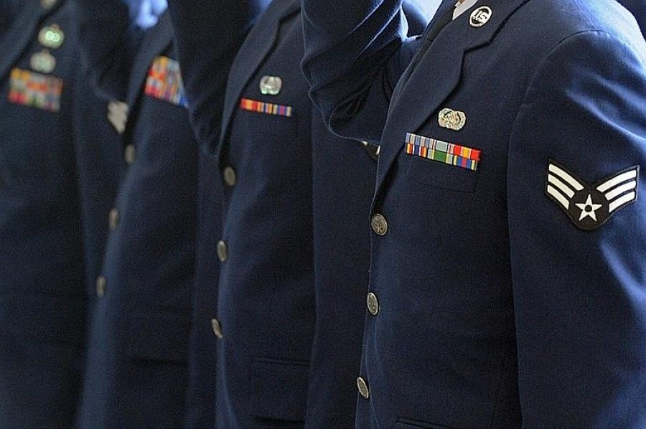
What is DAFI 36-2903?
Department of Air Force Instruction that outlines Air & Space Force dress and personal appearance standards for all personnel through the five elements of the standard: “neatness, cleanliness, safety, uniformity, and military image.”
Why You Should Care:
“Appearance in uniform exemplifies one’s military image. The American public and its elected representatives draw certain conclusions on military effectiveness based on the image Airmen present. The image of a disciplined and committed Airman instills public confidence that Airmen live by a common standard and respond to military order and discipline.”
*DAFI 36-2903
Air Force ROTC Detachment 842 • We Build Exceptional Officers • The University of Texas at San Antonio

Slide 15
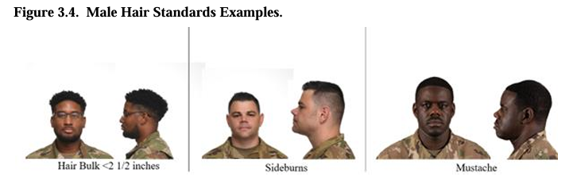
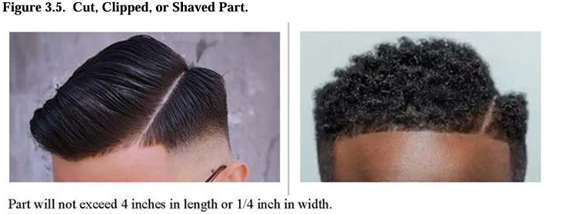
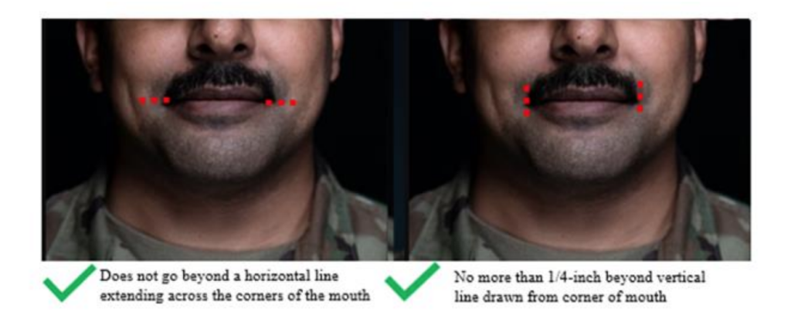
Male Hair Standards
Tapered appearance
Maximum 2 ½ inches in bulk
Only closely cut hair may touch the collar
Will not touch ears
Sideburns and mustache
Pgs. 19-25
*DAFI 36-2903
Air Force ROTC Detachment 842 • We Build Exceptional Officers • The University of Texas at San Antonio

Slide 16
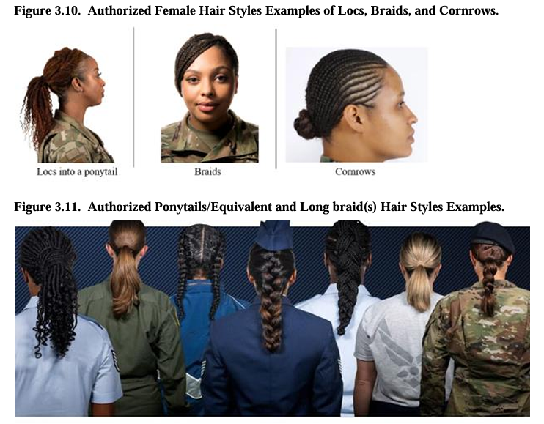
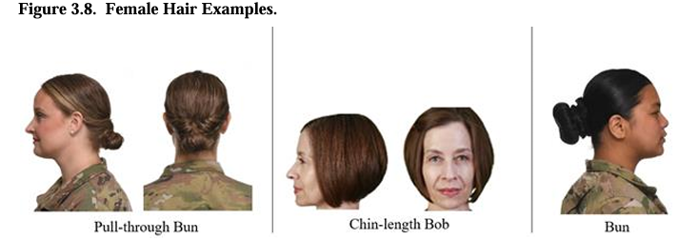
Female Hair Standards
No minimum length
Maximum 4 inches in bulk
Maximum 6 inch radius from gathering point
Short hair or bun must be above the collar
Bangs (May not cover eyes)
Long braids and ponytails
Only natural hair colors
Pgs. 19-25
*DAFI 36-2903
Air Force ROTC Detachment 842 • We Build Exceptional Officers • The University of Texas at San Antonio

Slide 17
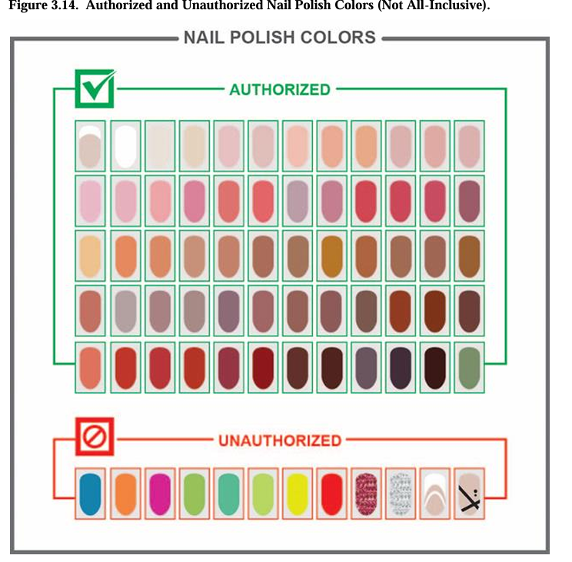
Nail Standards
Fingernails may not exceed 1/4 -inch in length
Males may not wear nail polish
Polish will be one solid color, non distracting from uniform
No designs or two-tone/ multi-tone colors (Only white-tip french manicures)
*DAFI 36-2903
Pg. 26
Air Force ROTC Detachment 842 • We Build Exceptional Officers • The University of Texas at San Antonio

Slide 18
Jewelry
Earrings (females only):
Only one set in lobes
Restricted to round or square white diamond, gold, white pearl, or silver earrings
6mm in diameter
Rings:
No more than 3
Wedding sets count as 1
Necklaces:
Will not be visible at any time, if worn must be concealed under collar or undershirt
* DAFI 36-2903
Air Force ROTC Detachment 842 • We Build Exceptional Officers • The University of Texas at San Antonio

Slide 19
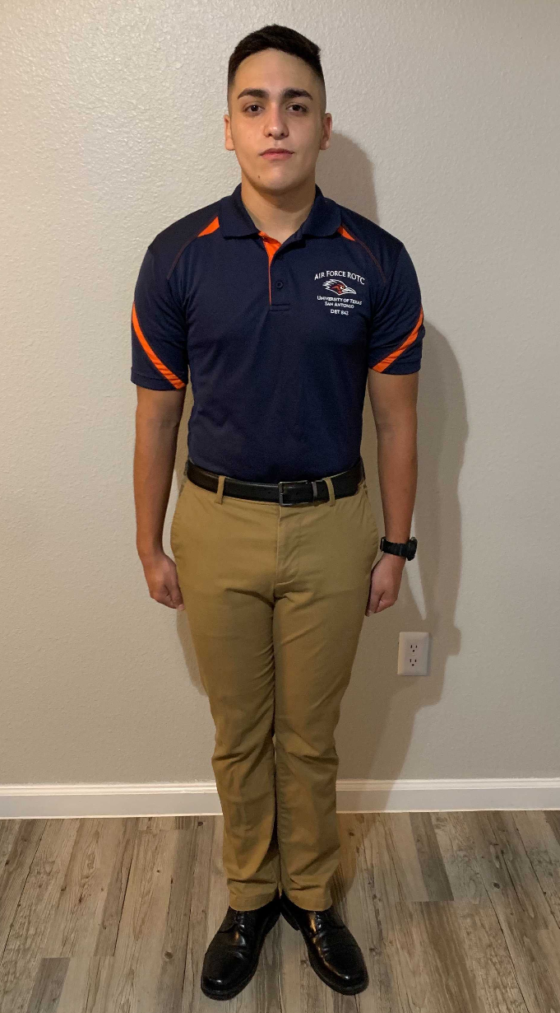
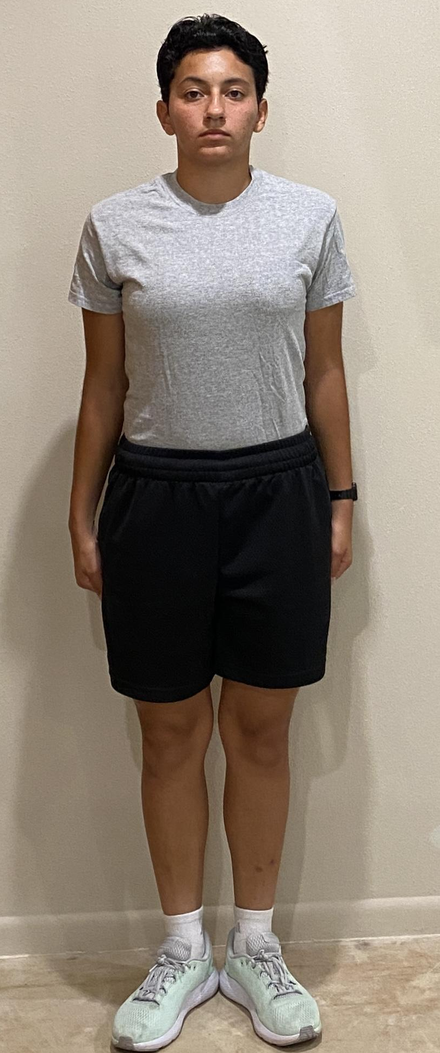
Uniforms
Alternates (Tuesdays & Thursdays 0800-1700): Khakis, Det Polo, Black Socks, Black Watch, Black Belt, and Black Dress Shoes.
PT Uniform: Grey Shirt, Black Shorts, White Socks, and Tennis Shoes.
Optional: Black leggings and/ or Long sleeve undershirt
Cold Weather Add-Ons: Black beanie(PT), Gloves, Black Jacket/ Hoodie.
*Minimal logos on all clothing*
* Detachment 842 Cadet Handbook
Air Force ROTC Detachment 842 • We Build Exceptional Officers • The University of Texas at San Antonio

Slide 20
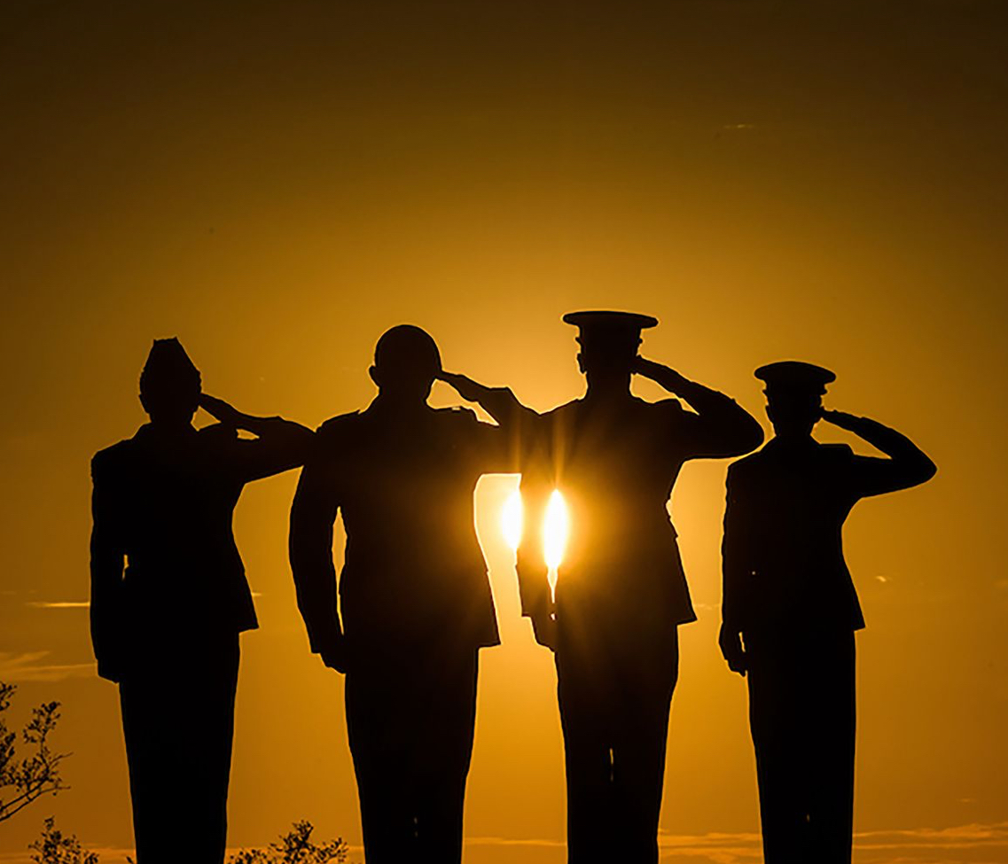
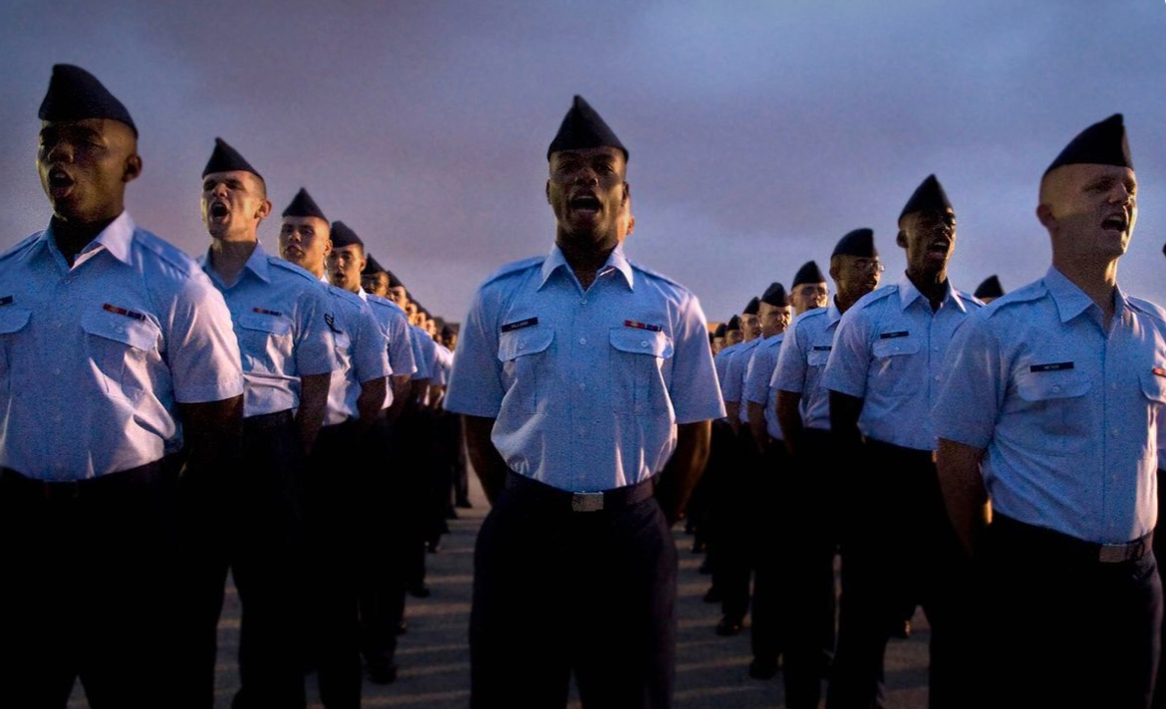
Uniform Etiquette
Professionalism (seven basic responses)
No headphones/ earbuds in while walking
No eating while walking
No sunglasses on top of head/ hanging on shirt (only out when being used for intended purpose)
No crude, rude, or vulgar language
Wear your uniform with PRIDE!
* DAFI 36-2903 & Detachment 842 Cadet Handbook
Air Force ROTC Detachment 842 • We Build Exceptional Officers • The University of Texas at San Antonio

Slide 21
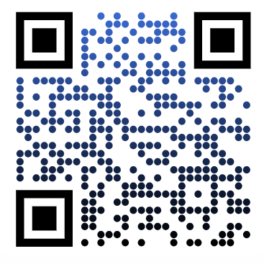
Overview
What is DAFI 36-2903?
Male Hair Standards
Female Hair Standards
Nail Standards
Jewelry
Uniforms
Uniform Etiquette
Summary
Questions
Air Force ROTC Detachment 842 • We Build Exceptional Officers • The University of Texas at San Antonio

Slide 22
Questions?

Slide 23
Det 842 Honor Guard
C/Atkinson & C/Fulk
AFROTC Detachment 842, UTSA

Slide 24
Overview
What HG Is
Expectations
Benefits
Practices
Summary
Air Force ROTC Detachment 842 • We Build Exceptional Officers • The University of Texas at San Antonio

Slide 25
What is Honor Guard?

Slide 26

What Is HG? What Do We Do?
Ensure the preservation of Air Force heritage through training, an adherence to standards, and a promotion of traditions
Represent the United States Air Force & Detachment at public and official ceremonies
Represent all Airmen who have served and sacrificed for the United States—past, present, and future
Perform Honor Guard Drill & Ceremonies at many events
Air Force ROTC Detachment 842 • We Build Exceptional Officers • The University of Texas at San Antonio

Slide 27
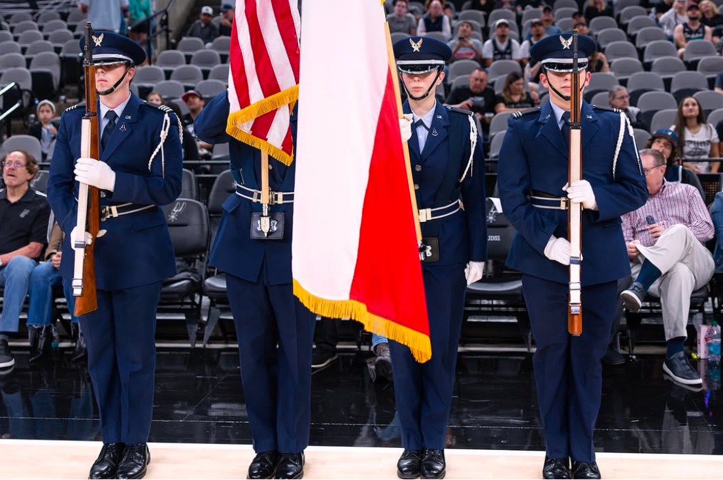
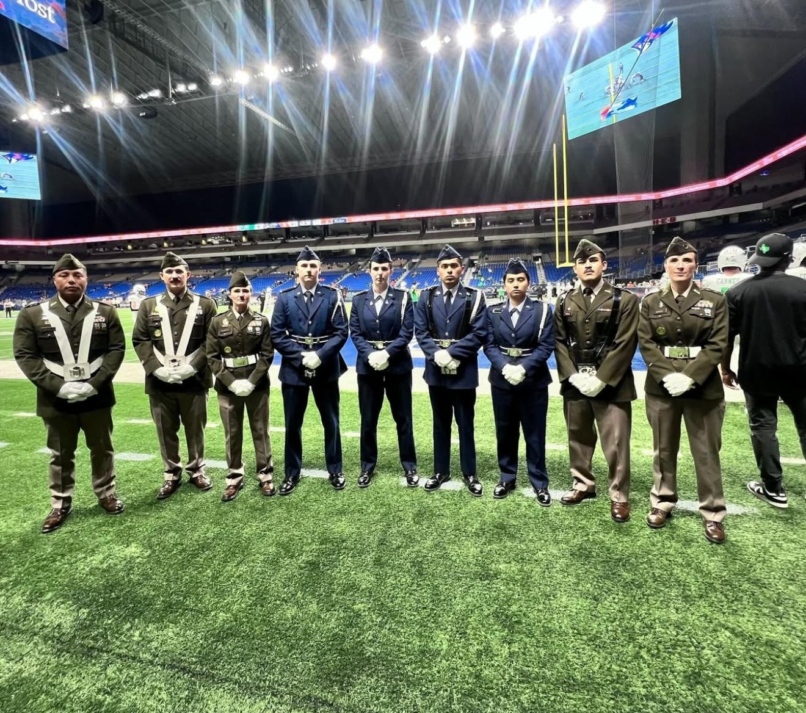
Event Pictures
Serve the community in many ways!
Air Force ROTC Detachment 842 • We Build Exceptional Officers • The University of Texas at San Antonio
Notes:
Pictures can be added to the slide show.

Slide 28
Expectations

Slide 29
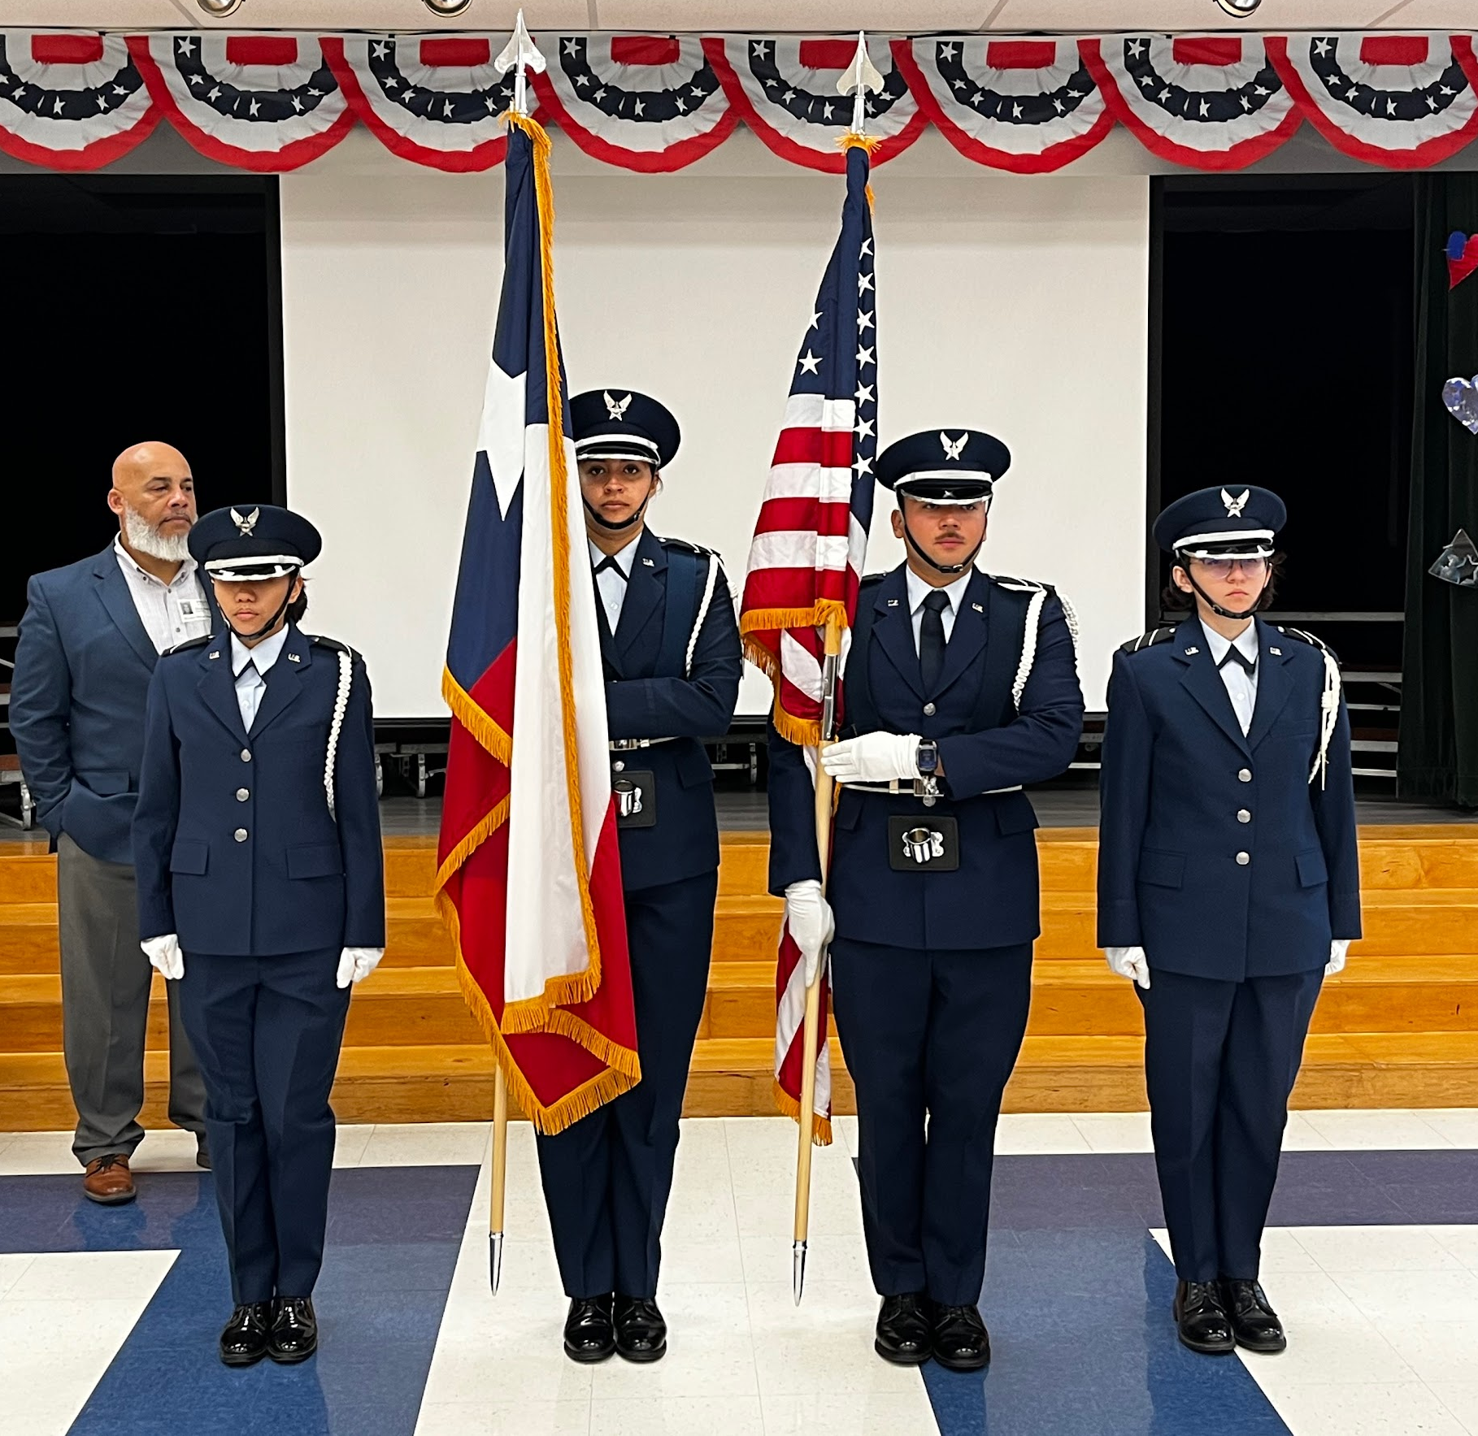
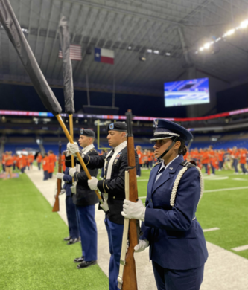
What Is Expected
Determination
Dedication
Attend Practices
Team Mindset
Good Attitude!
Represent the Best = Look the Best
Air Force ROTC Detachment 842 • We Build Exceptional Officers • The University of Texas at San Antonio
Notes:
Pictures can be added to the slide show.

Slide 30
Benefits

Slide 31
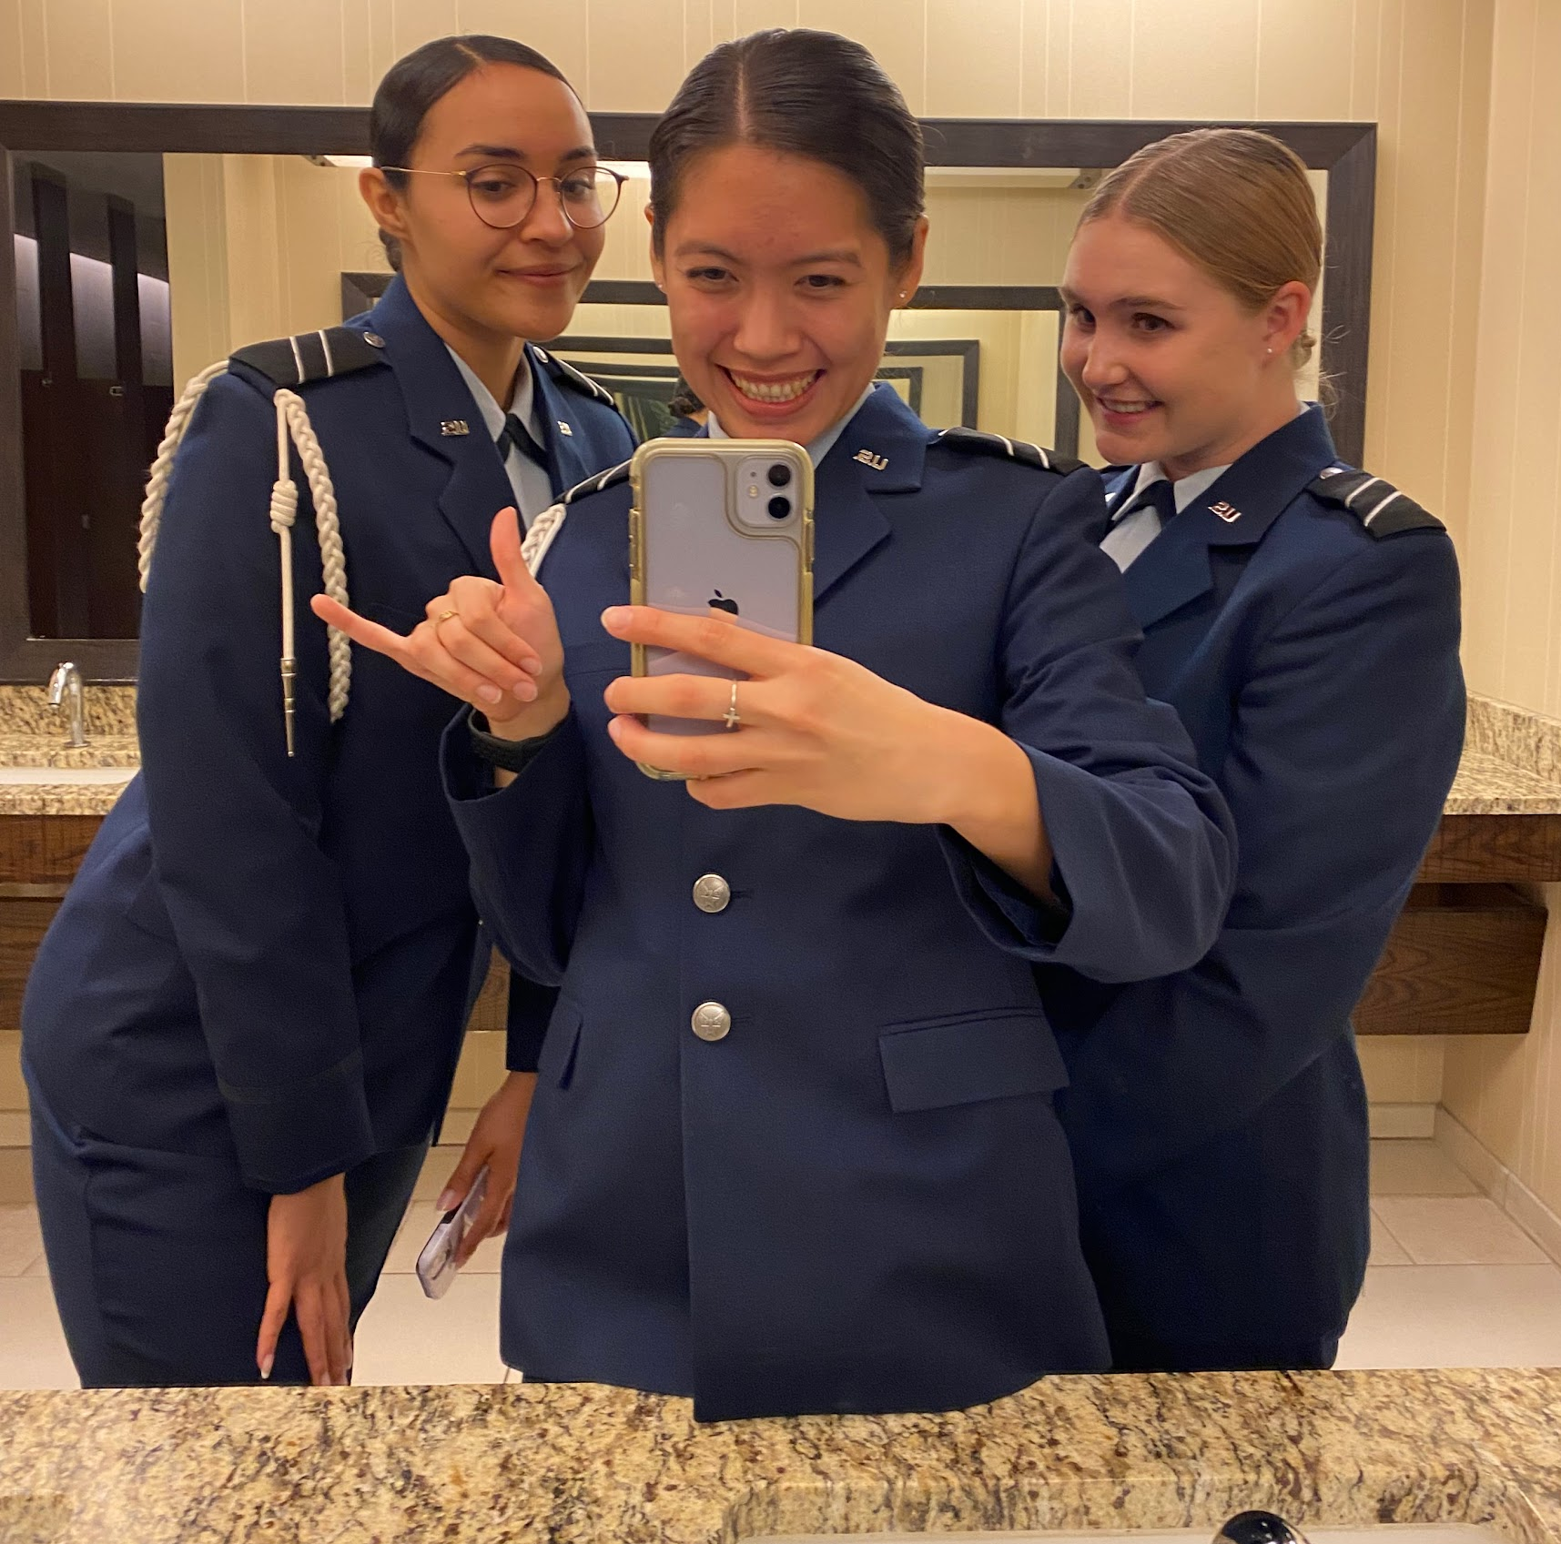
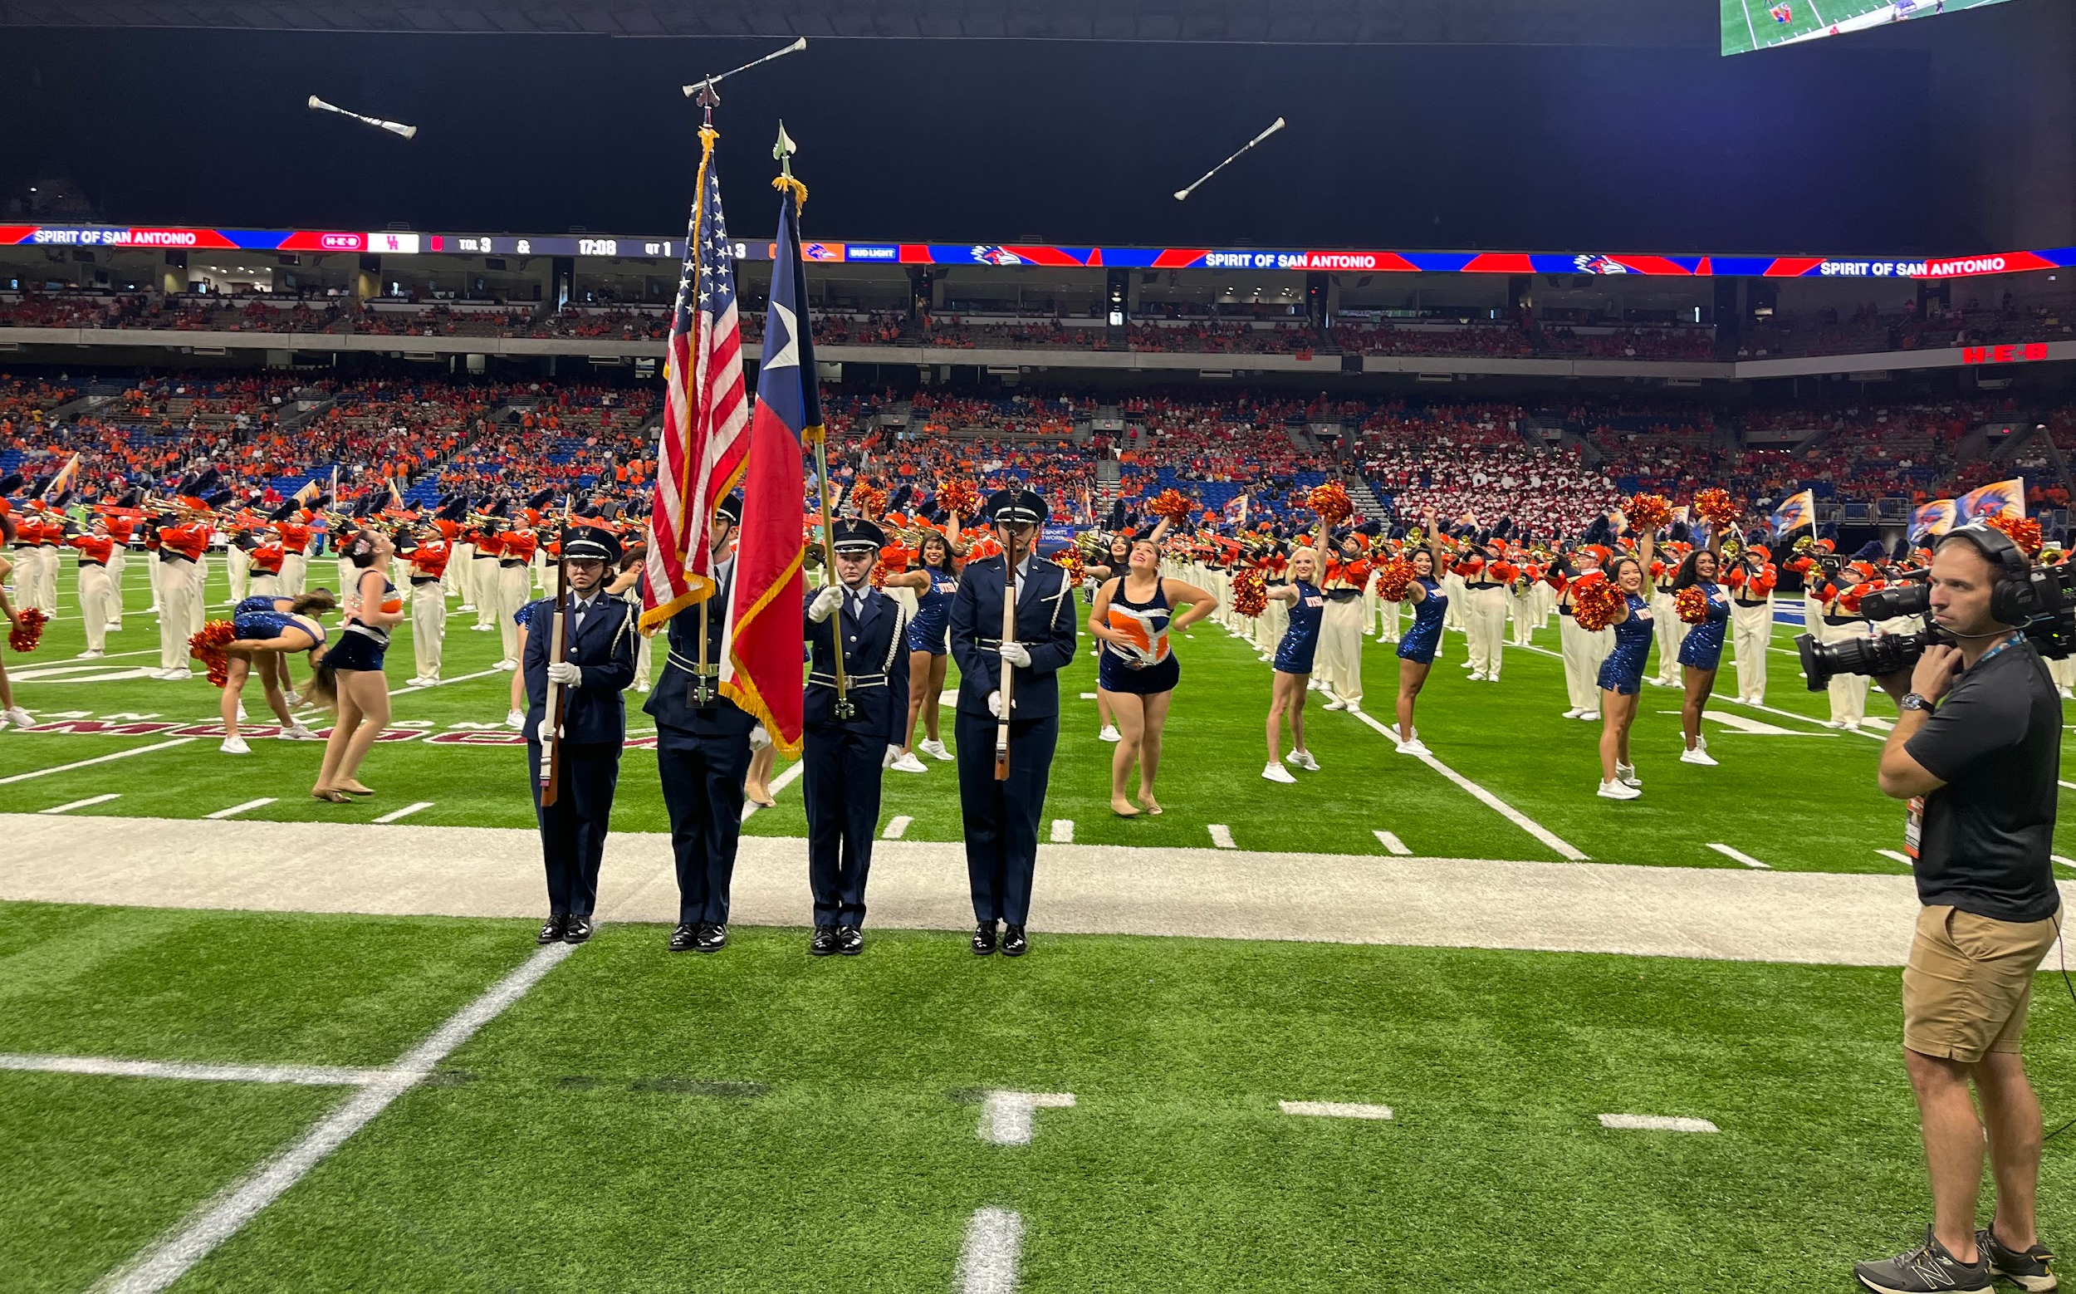
Benefits of Being In HG
Leadership
Connection with Peers
Opportunities / Stand Out
Getting your blues early!
Air Force ROTC Detachment 842 • We Build Exceptional Officers • The University of Texas at San Antonio
Notes:
Pictures can be added to the slide show.

Slide 32
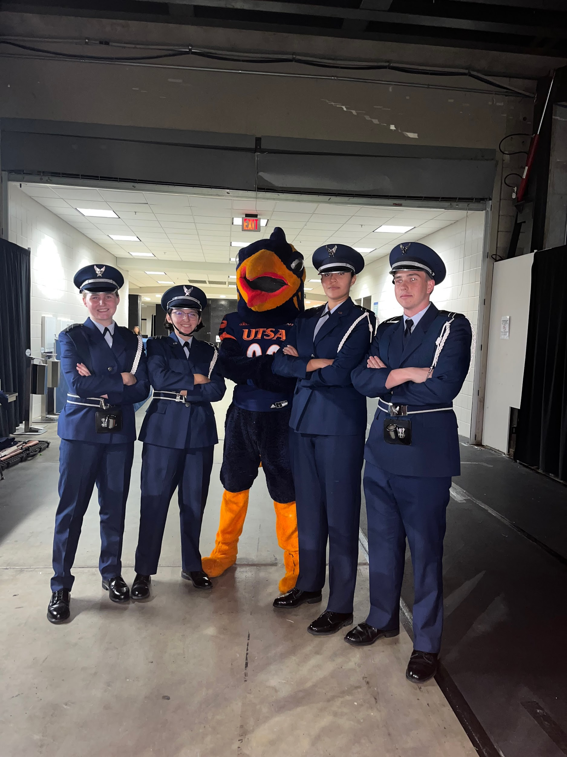
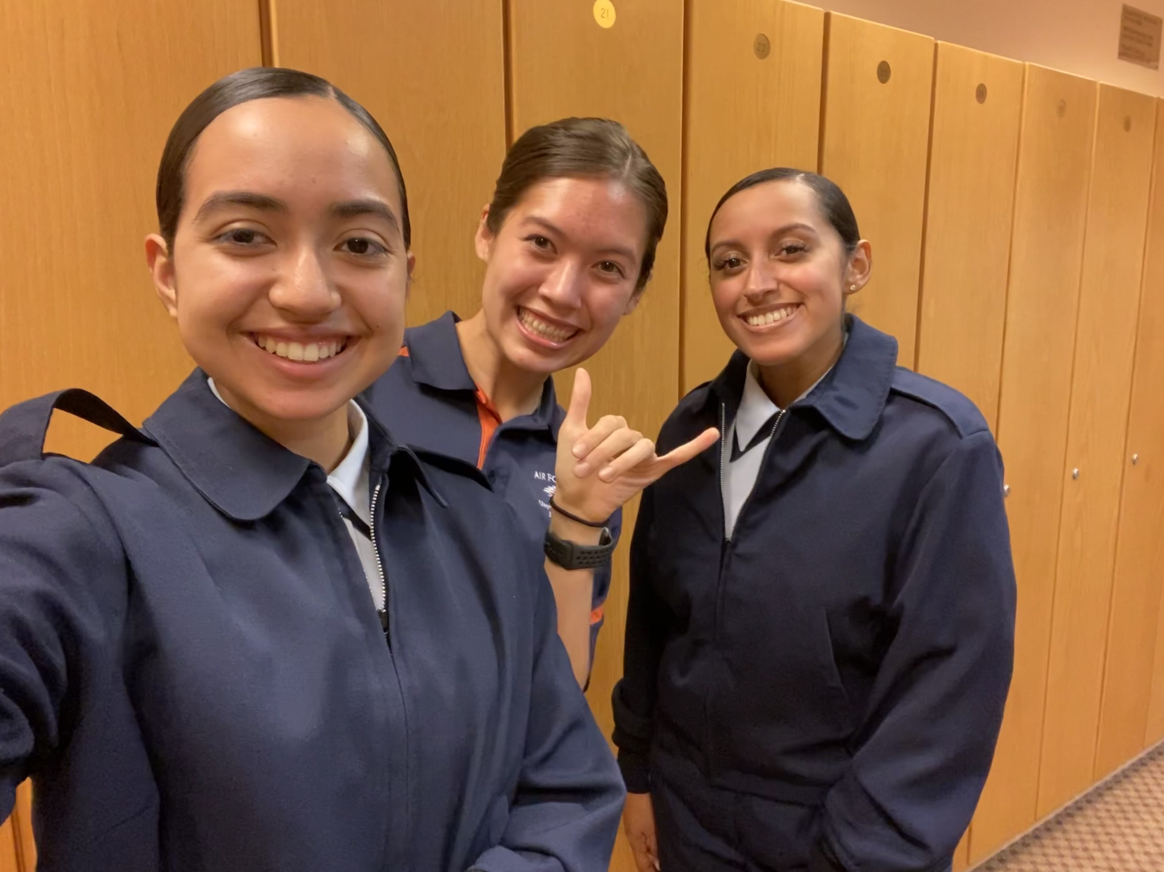
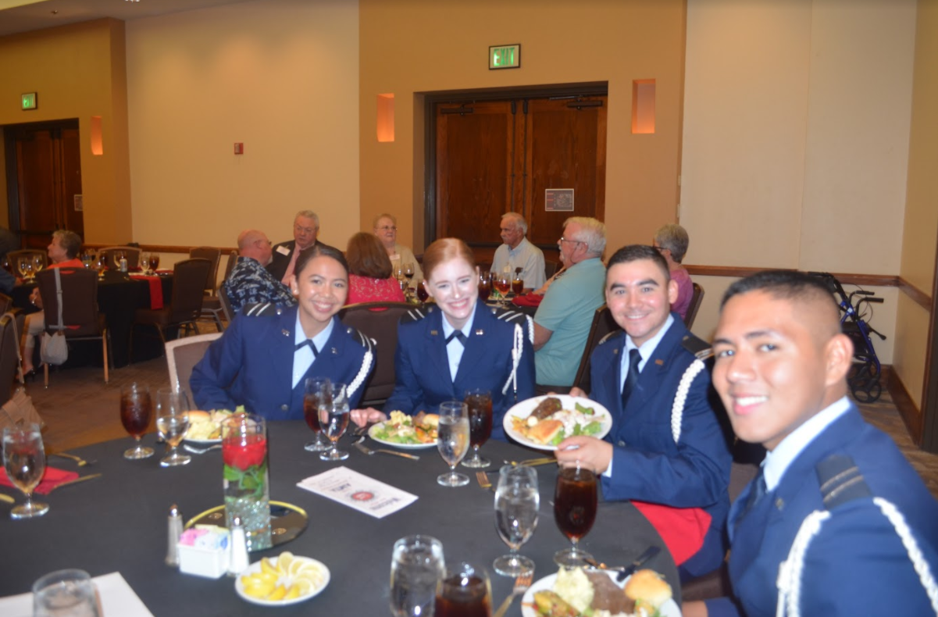
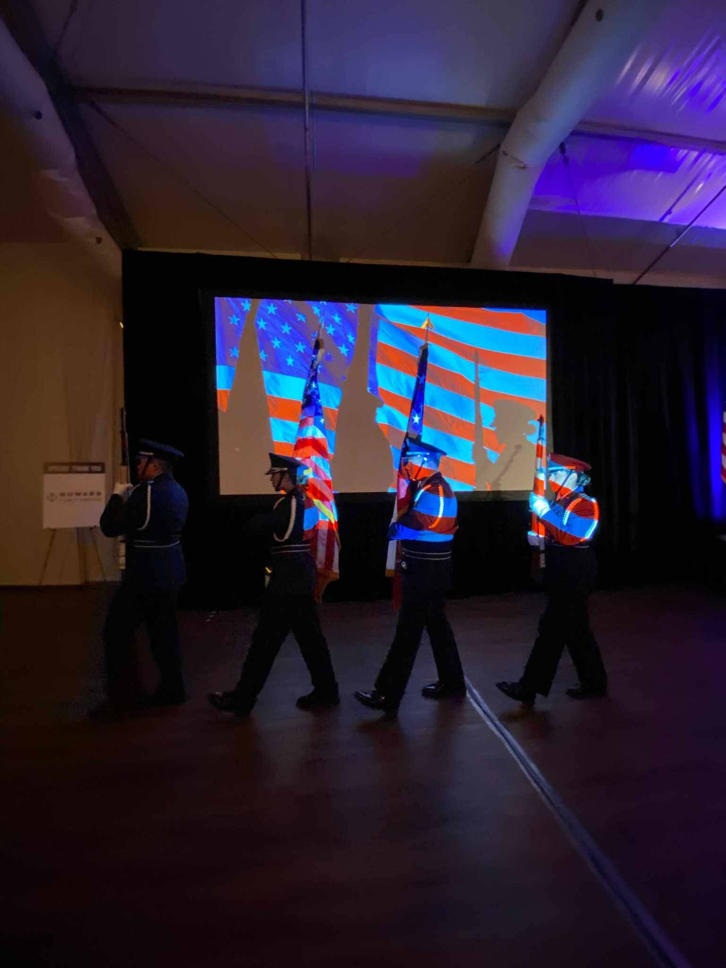
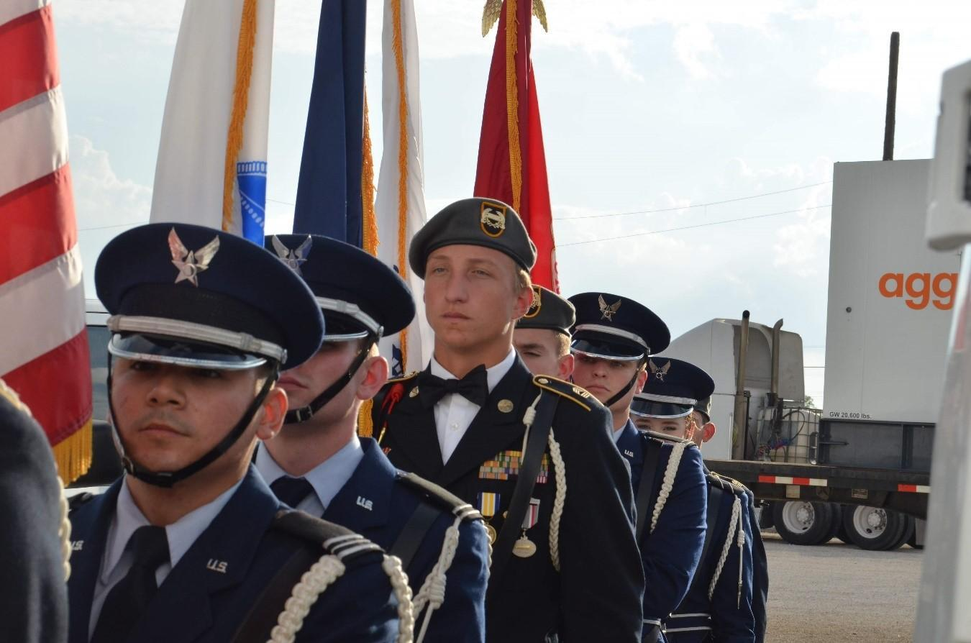
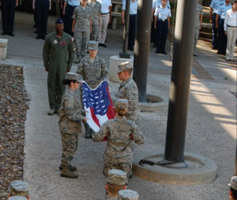
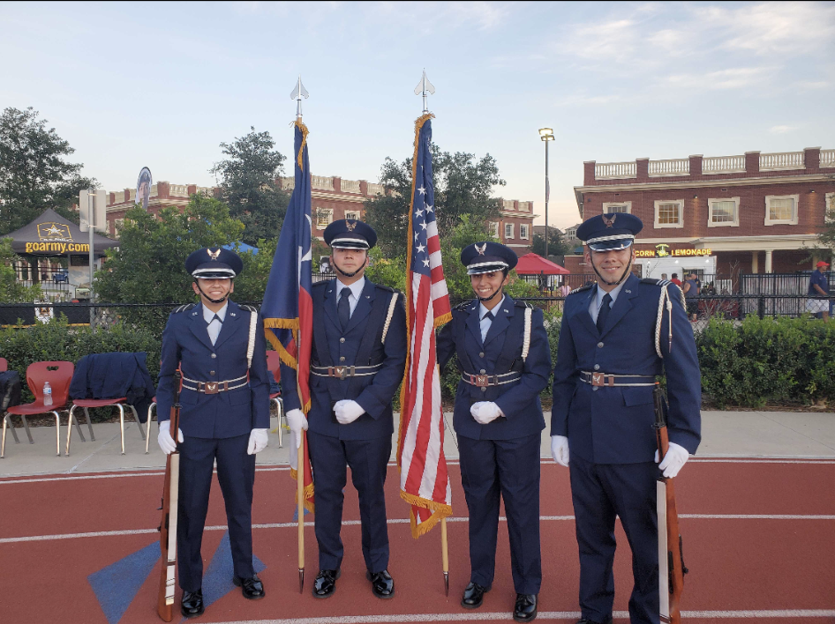
More Event Pictures
Air Force ROTC Detachment 842 • We Build Exceptional Officers • The University of Texas at San Antonio
Notes:
Pictures can be added to the slide show.

Slide 33

Summary
What is HG?
Expectations
Benefits
Practices
Summary
Air Force ROTC Detachment 842 • We Build Exceptional Officers • The University of Texas at San Antonio
Notes:
Should mirror the Overview

Slide 34
Questions?

Slide 35



i5
15 January 2025

Slide 36

Overview
What is i5
Why should you join
How you can join

Slide 37
What is i5
i5 Space is a national student organization that works with the U.S. Space Force.
Focuses on Cyber, Space Force, and Wargaming
i5 Mission statement
Is to educate and inspire leaders for the Space Force.

Slide 38
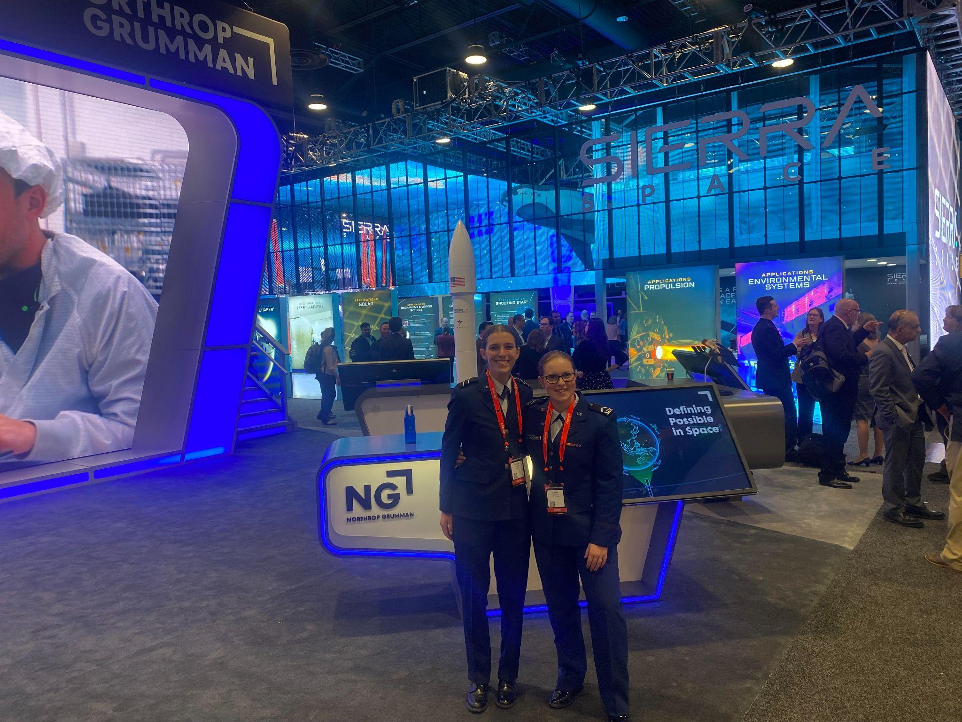
Why should you join
Unique opportunities only for i5 members
Leadership opportunities
Unique challenges

Slide 39
How can you join
Showing up! 80%
National exam
Meeting every wednesday! Starting the second week of school!

Slide 40

Questions?

Slide 41
Booster Club
C/Rodriguez & C/Trevino
AFROTC Detachment 842, UTSA, 17 Jan 25

Slide 42
Overview
Staff
Events
Our “Why”
Summary
Air Force ROTC Detachment 842 • We Build Exceptional Officers • The University of Texas at San Antonio

Slide 43
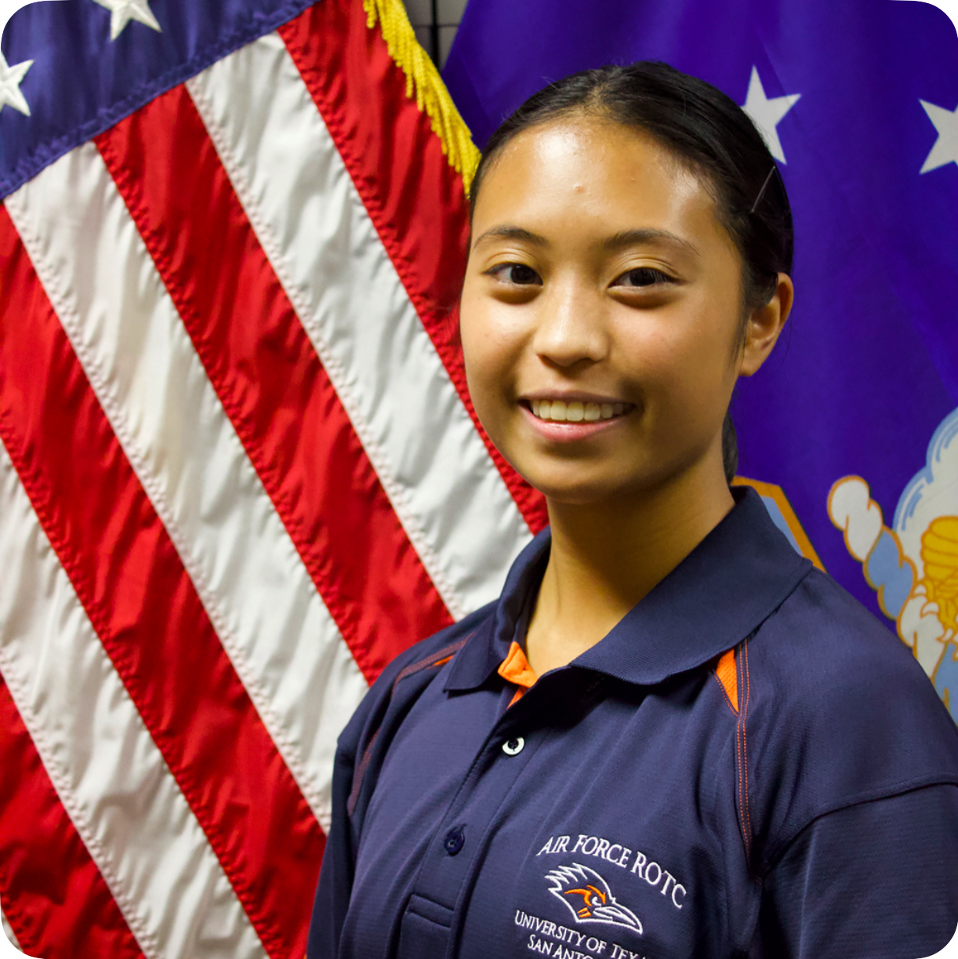
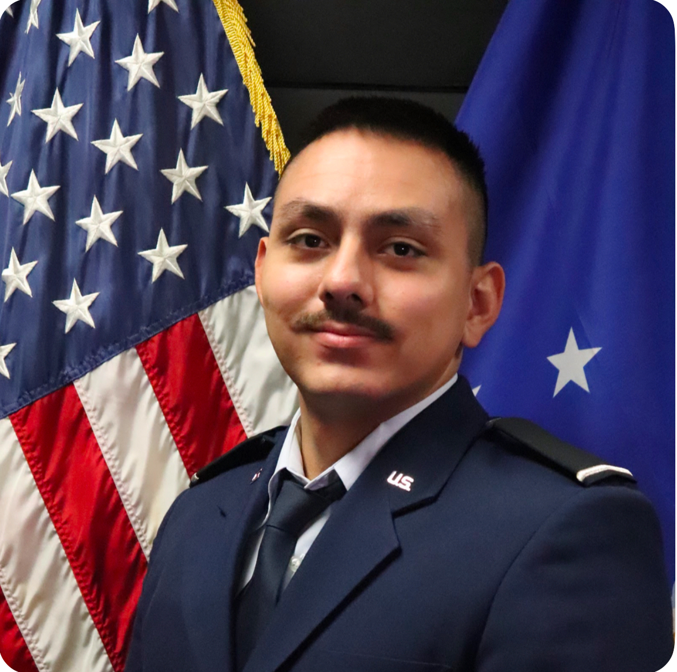
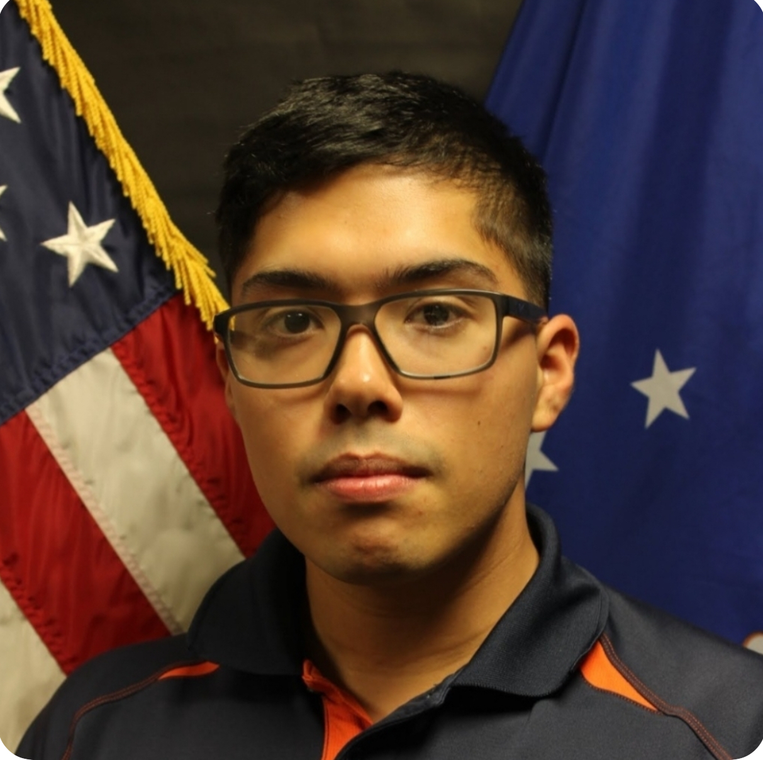
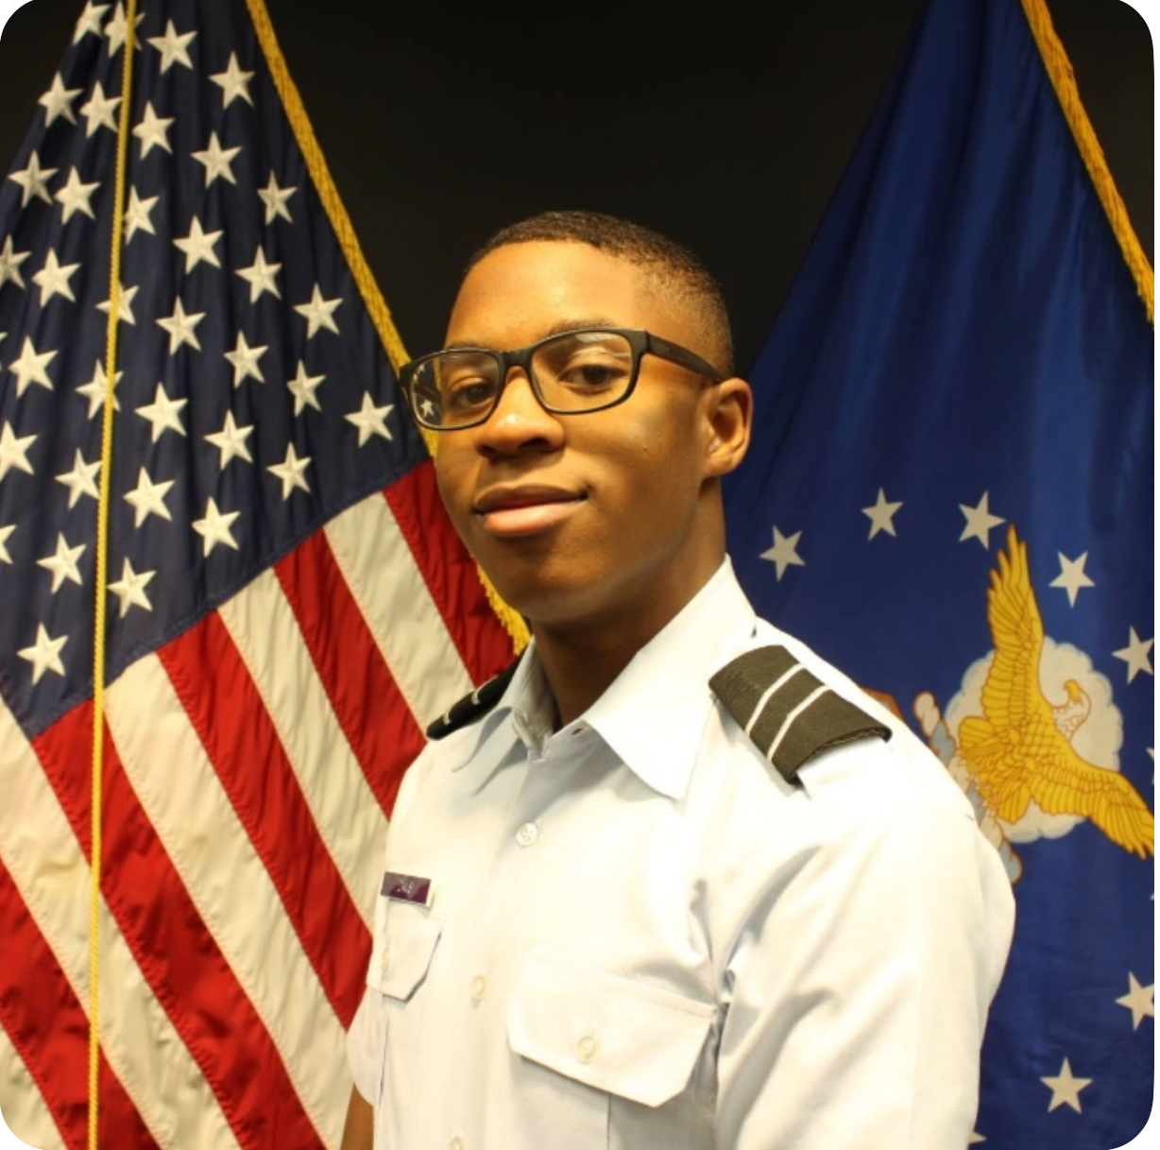
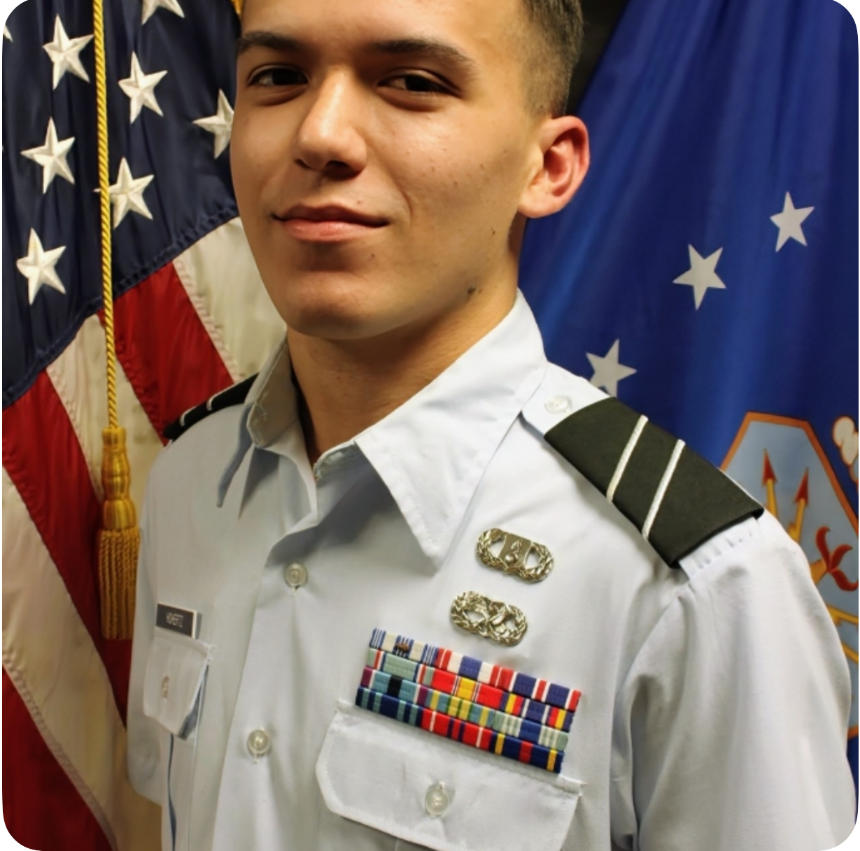
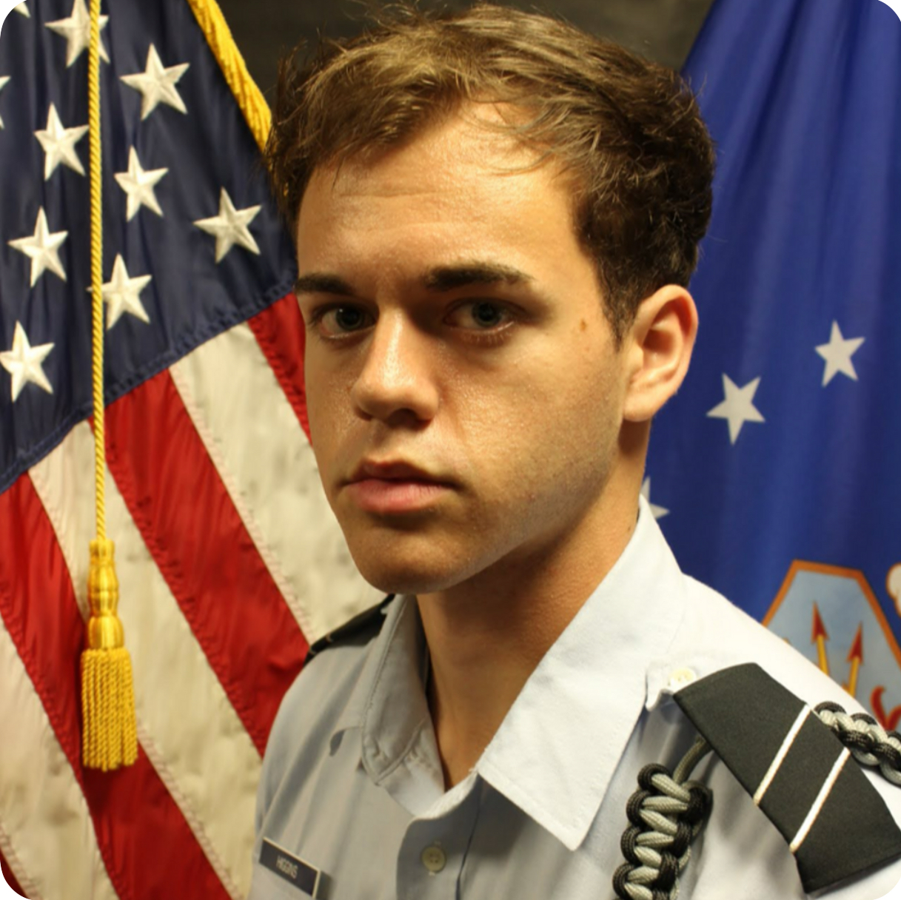
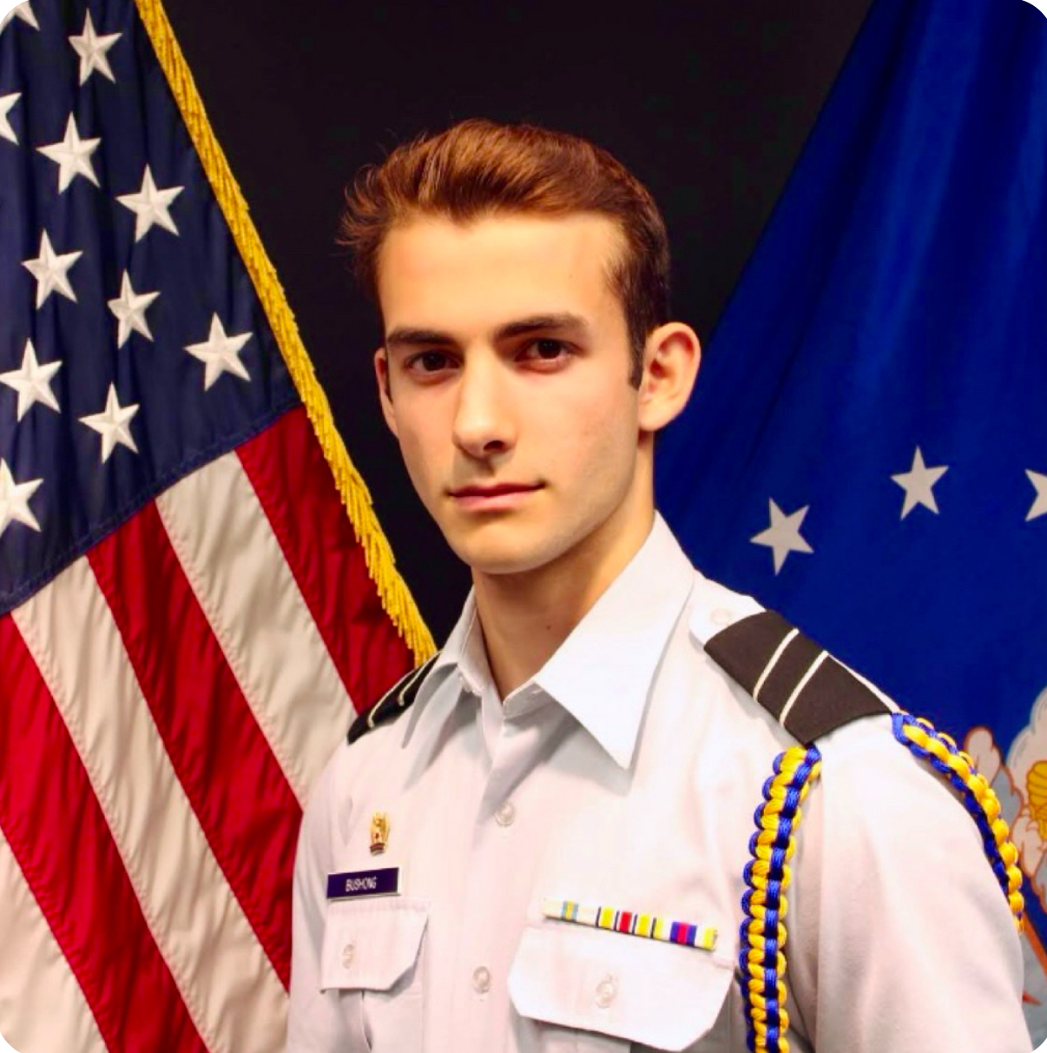
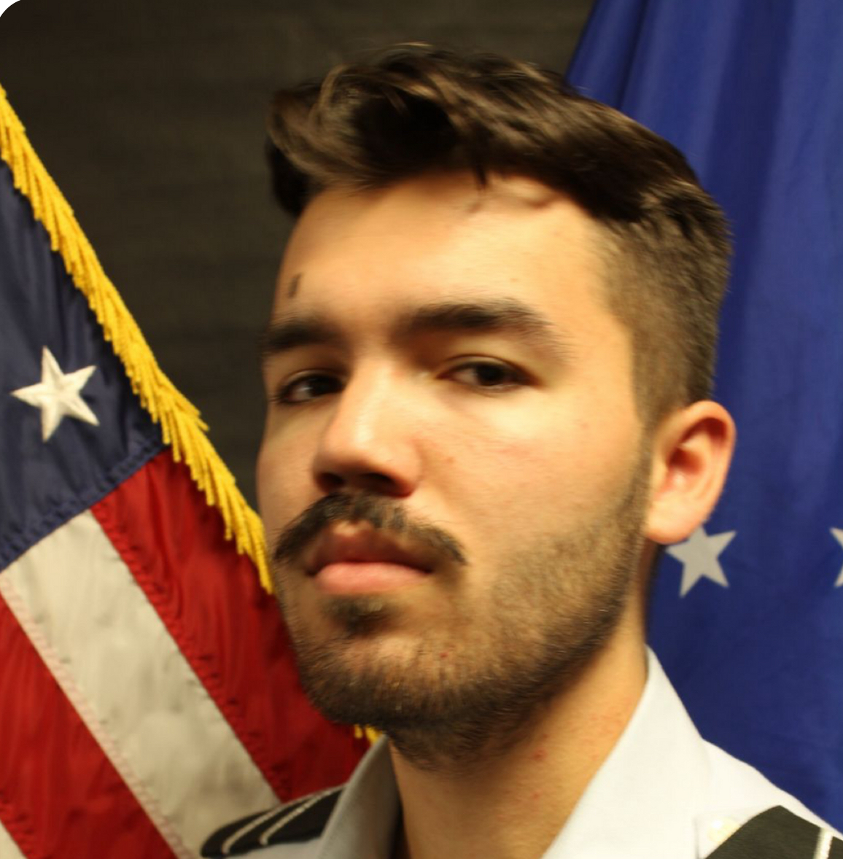
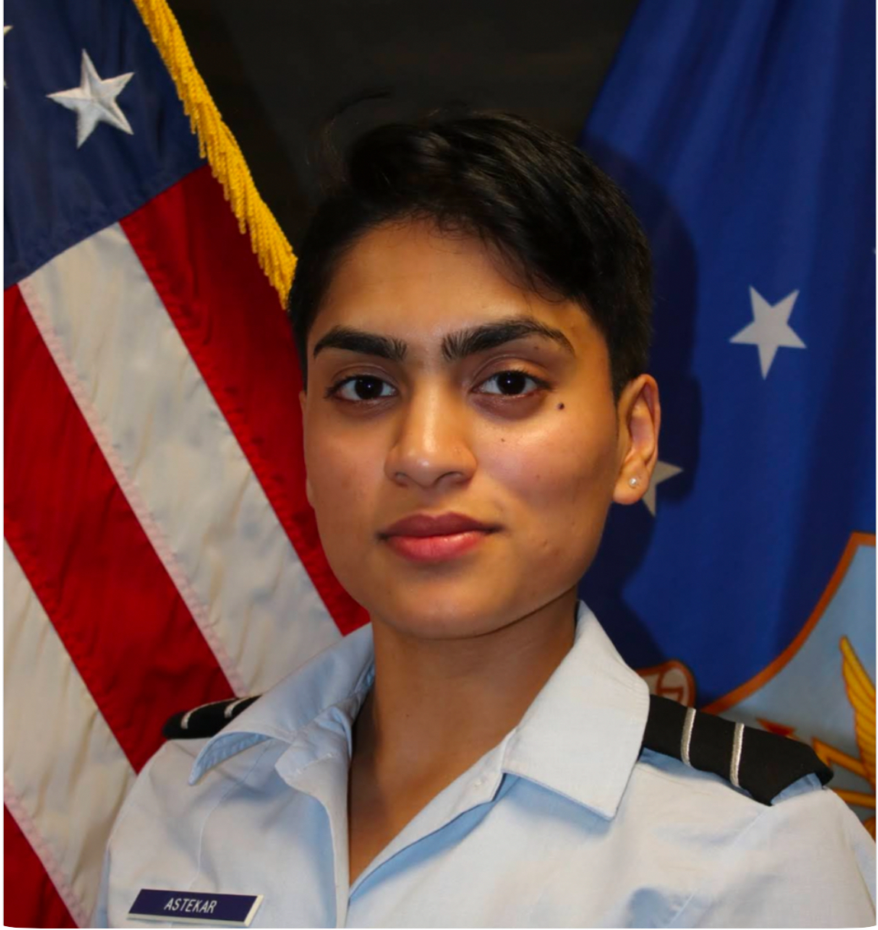
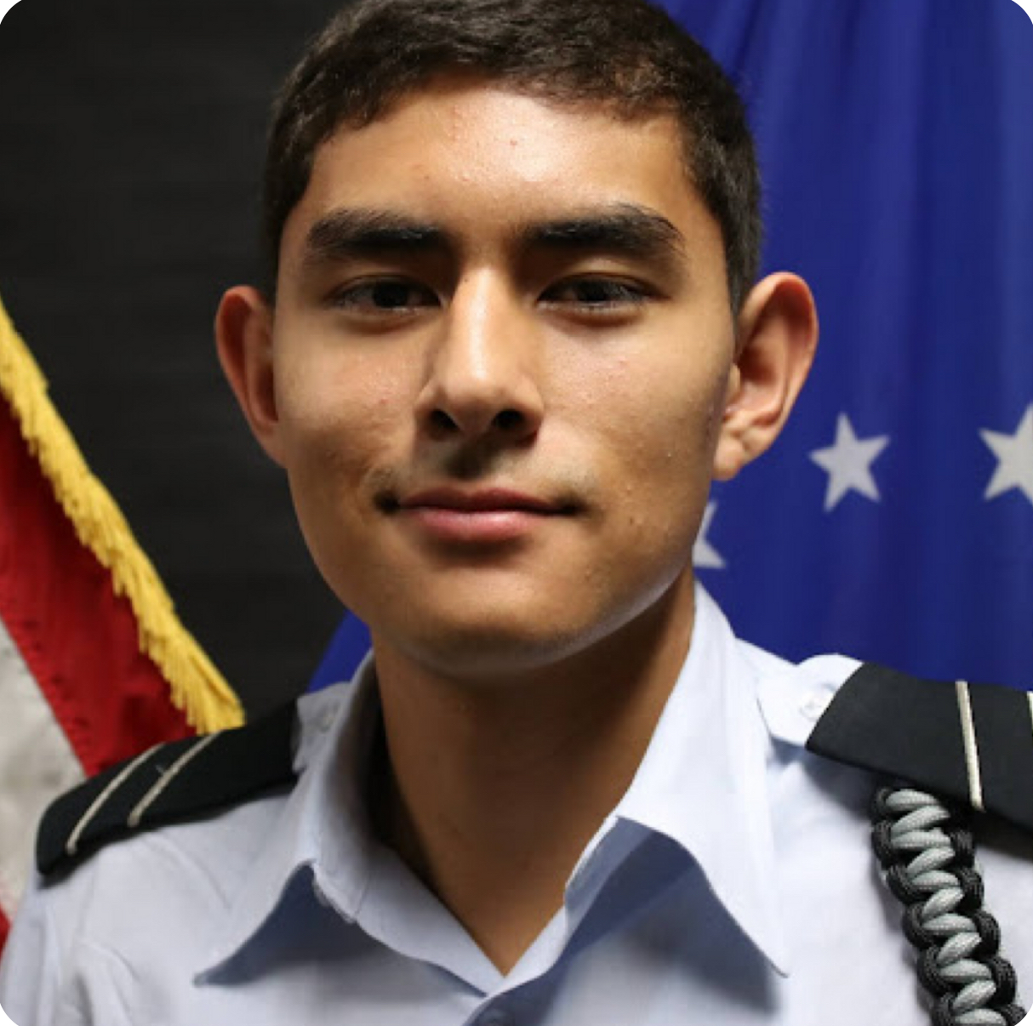
Staff
C/Villamaria-Photographer
C/Rodriguez-President
C/Trevino-Vice President
C/Davis-Events
C/Hohertz-Photographer
C/Shook-Sales
C/Bushong-Sales
C/Glasser-Snack
C/Astekar-Snack
C/Solis-Events
Air Force ROTC Detachment 842 • We Build Exceptional Officers • The University of Texas at San Antonio

Slide 44
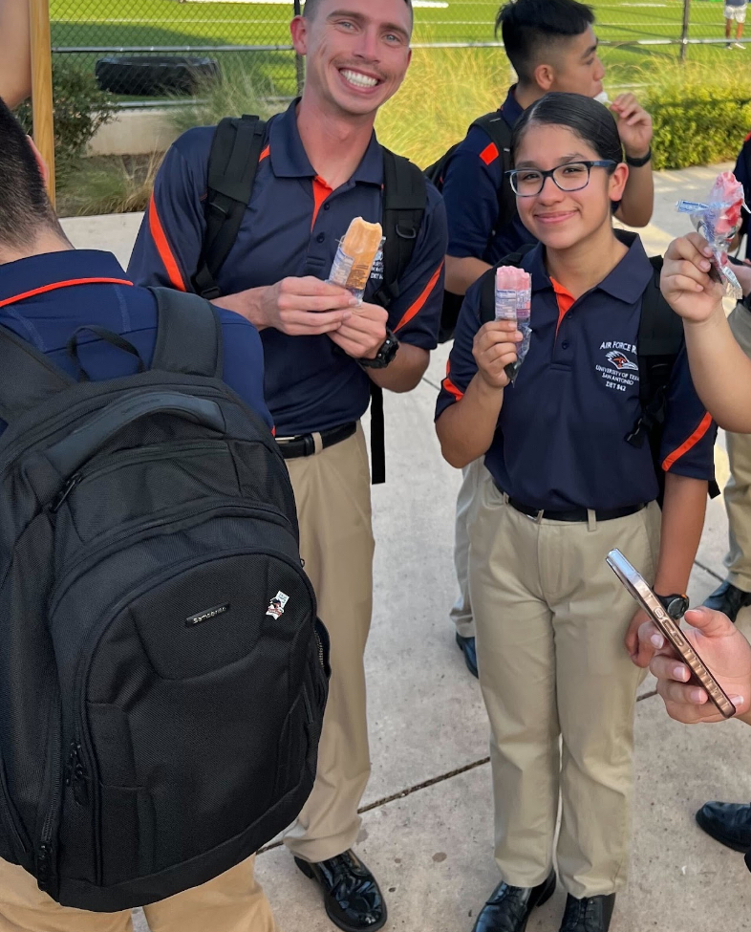

Events
Holiday socials
Detachment wide contests
Post Lead Lab fundraisers
Air Force ROTC Detachment 842 • We Build Exceptional Officers • The University of Texas at San Antonio

Slide 45


Our “Why”
To raise morale among cadets
To provide necessities for the detachment
Air Force ROTC Detachment 842 • We Build Exceptional Officers • The University of Texas at San Antonio

Slide 46
Summary
Staff
Events
Our “Why”
Summary
Air Force ROTC Detachment 842 • We Build Exceptional Officers • The University of Texas at San Antonio

Slide 47
Questions?

Slide 48
Det 842 Silver Wings
C/Kiang, Samantha
AFROTC Detachment 842, UTSA

Slide 49

Overview
What is Silver Wings?
What Do We Do?
Who Can Join?
Air Force ROTC Detachment 842 • We Build Exceptional Officers • The University of Texas at San Antonio

Slide 50


What Is Silver Wings?
Personal and professional development regardless of your career choice.
Air Force ROTC Detachment 842 • We Build Exceptional Officers • The University of Texas at San Antonio

Slide 51

What Do We Offer?
Networking In and Out of AFROTC
Regional and National Leadership Opportunities
Internships and Scholarships
Community Service Opportunities
Air Force ROTC Detachment 842 • We Build Exceptional Officers • The University of Texas at San Antonio

Slide 52

Who Can Join?
Civilian College Students
Army Cadets
Air Force Cadets
Air Force ROTC Detachment 842 • We Build Exceptional Officers • The University of Texas at San Antonio

Slide 53

Summary
What is Silver Wings?
What Do We Offer?
Who Can Join?
Air Force ROTC Detachment 842 • We Build Exceptional Officers • The University of Texas at San Antonio

Slide 54
Questions?

Slide 55

Air Force ROTC Detachment 842
The University of Texas at San Antonio
Det 842 – Best in Blue

